Slide 1







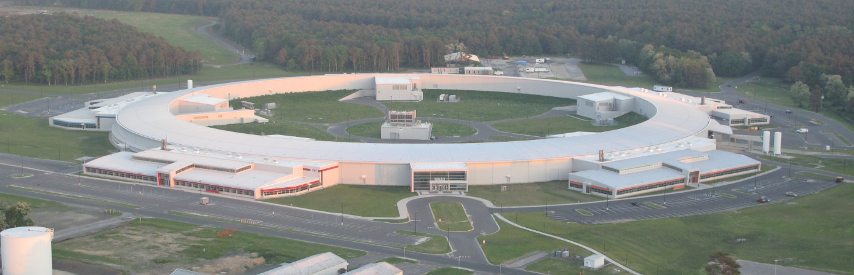
Introduction to "Synchrotron Radiation Workshop"
NSLS-II @ BNL
O. Chubar
Photon Sciences Directorate, BNL
Synchrotron Optics Simulations: 3-Codes Tutorial
3 - 5 June 2013, ESRF, France

Slide 2
Outline
Light Source Developments Driving the Needed Improvements in X-Ray Optics Simulation and Modeling
Some Details of Single-Electron Undulator Radiation
Method for Simulation of Emission and Propagation of Partially-Coherent SR
Simulation Examples: Beamlines and Experiments
Current Status of SRW and Collaborations
Summary

Slide 3
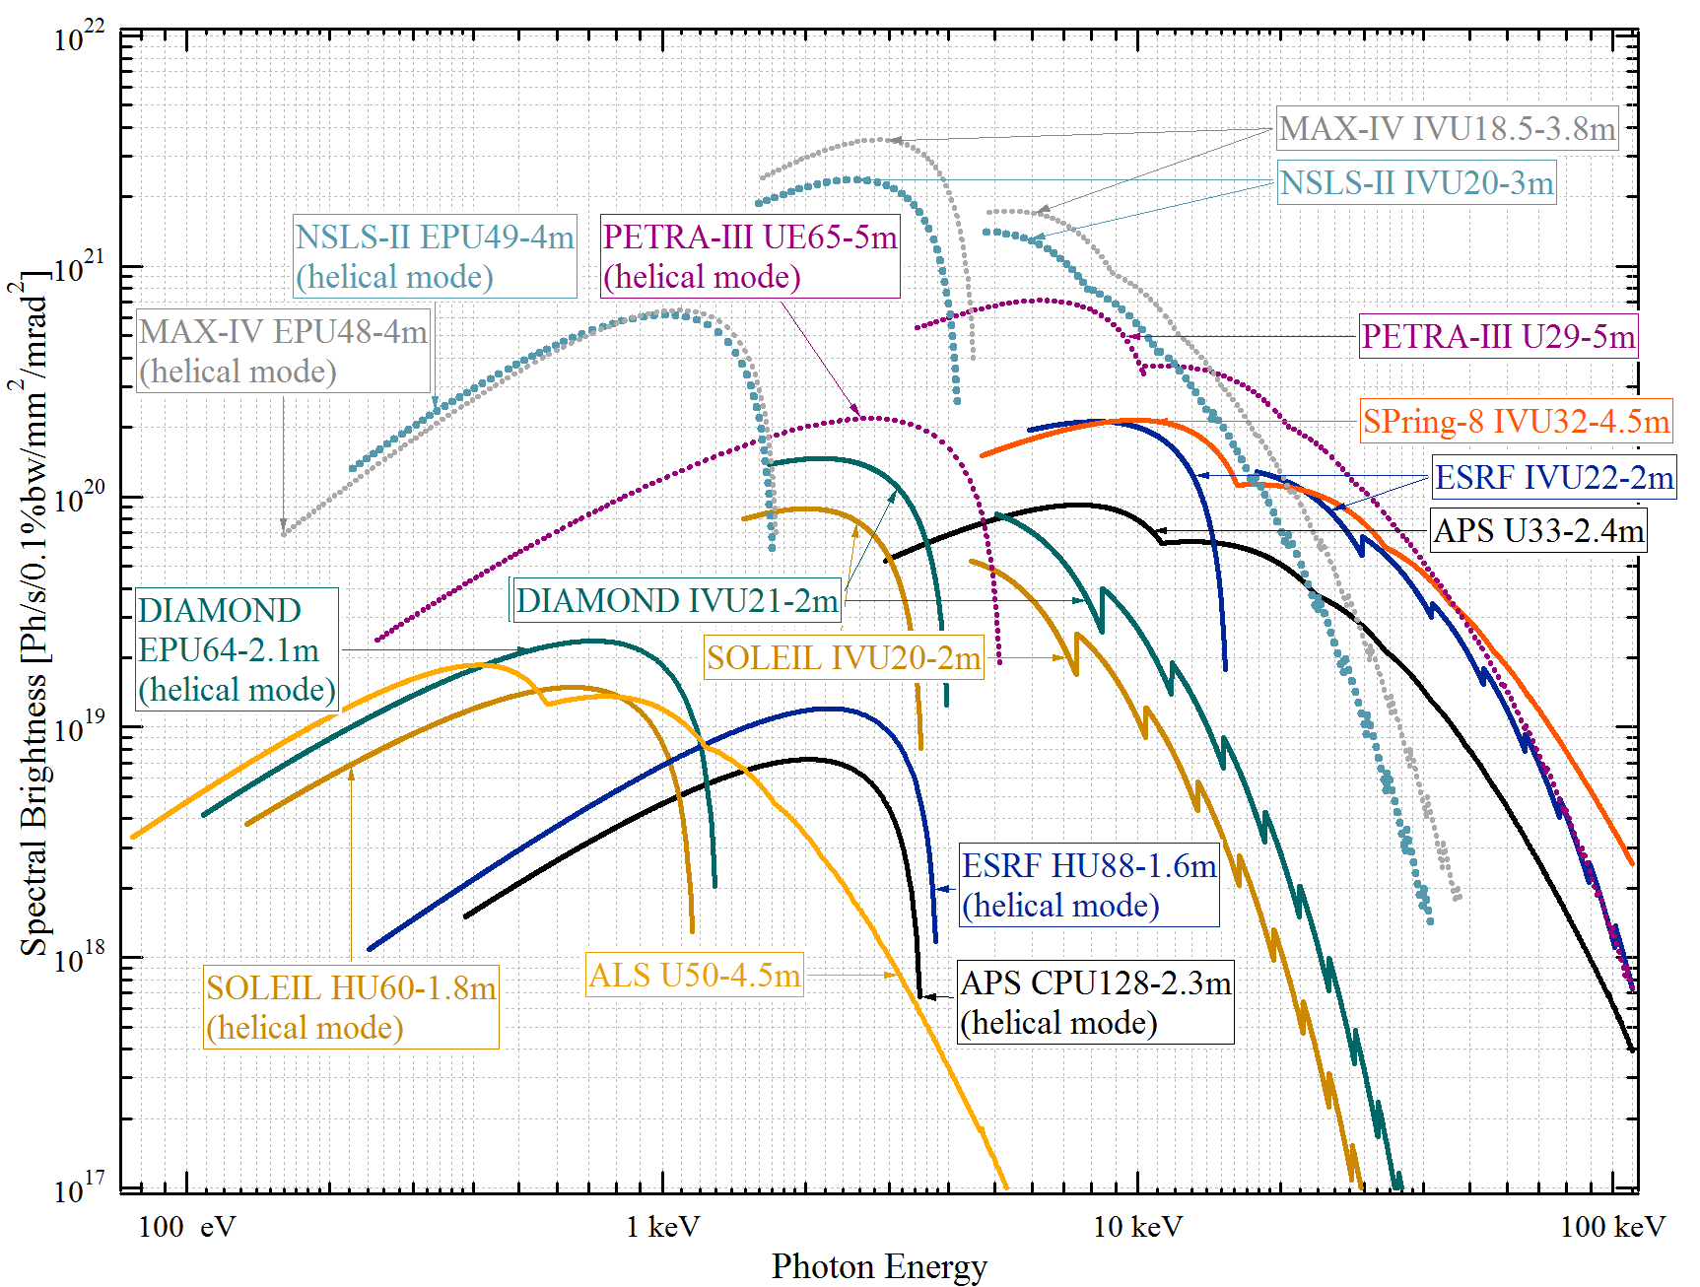
Approximate Spectral Brightness of Undulator Sources in 3rd(+) Generation Storage Rings
ε_{x} = 0.26 nm
ε_{x} = 0.55 nm
ε_{x} = 1.0 nm
ε_{x} = 3.4 nm
ε_{x} = 2.8 nm
NOTE: the “Coherent Flux” is proportional to Brightness:
Curves take into account e-beam emittance and energy spread
…however some source parameters may be not up-to-date…

Slide 4
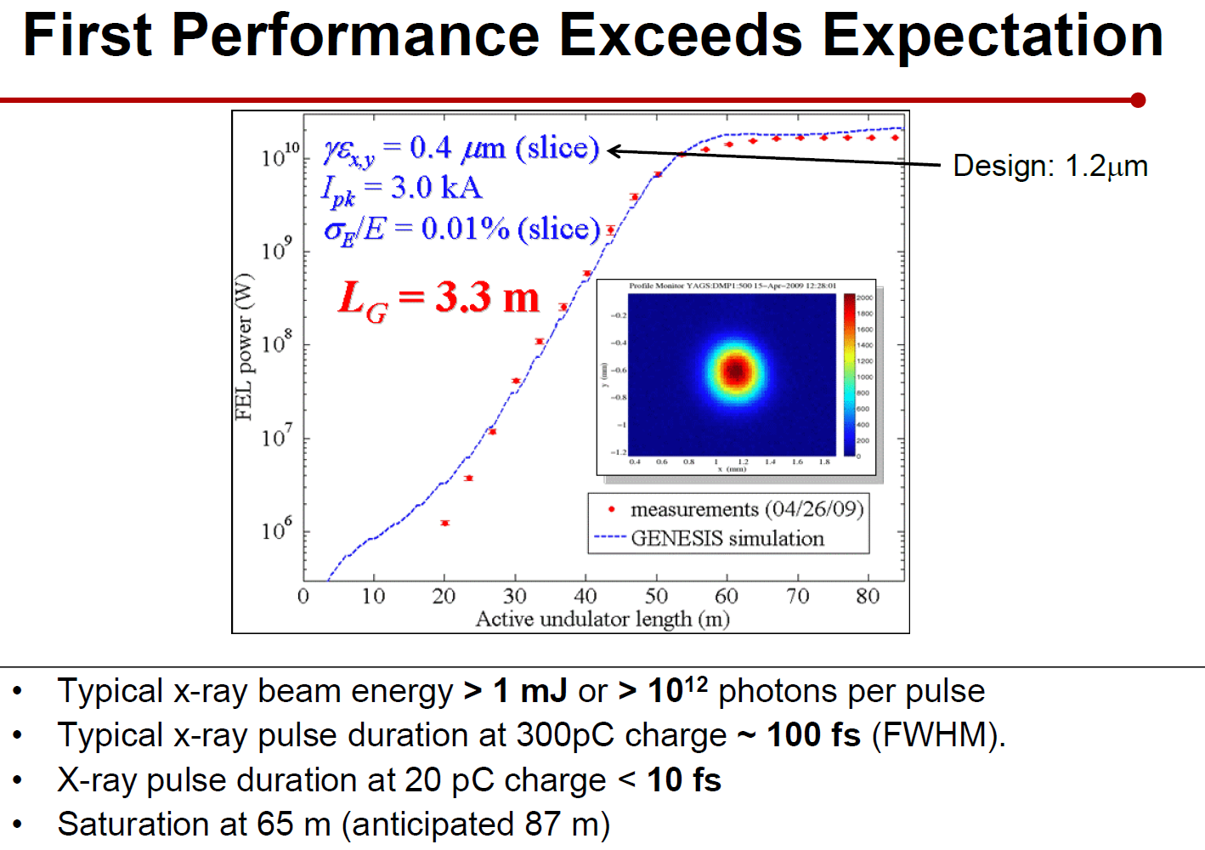

The Turn on of LCLS:
From presentations of
P. S. Drell (2009)
P. Emma, PAC-2009

Slide 5
General Motivation: Start To End Simulation
B(r)
SR
BL
e⁻
• Computation of Magnetic Fields produced by Permanent Magnets, Coils and Iron Blocks and in 3D space, optimized for the design of Accelerator Magnets, Undulators and Wigglers
RADIA
• Fast computation of Synchrotron Radiation emitted by relativistic electrons in Magnetic Field of arbitrary configuration
• SR Wavefront Propagation (Physical Optics)
• Simulation of some Experiments involving SR
SRW
Started at ESRF thanks to Pascal Elleaume

Slide 6

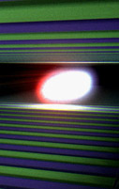
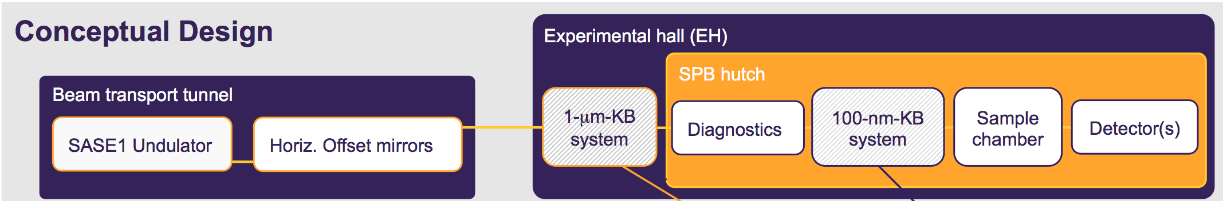

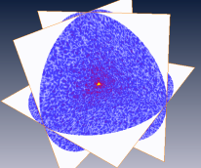
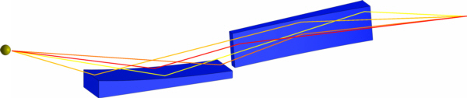
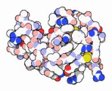
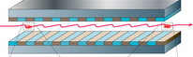

Single particle imaging at the SPB instrument of the European XFEL–from start to end II
Start-to-End modelling project for X-ray Free Electron Laser Scattering Experiments
6
Courtesy of A. P. Mancuso and L. Samoylova
Source radiation
properties
Beam propagation
and x-ray optics
Detector effects
Reconstruction
Classification &
3D assembly
Photon-matter interaction
Images: Nature Photonics 4, 814–821 (2010), x-ray-optics.de, pdb.org, J. Phys. B: At. Mol. Opt. Phys. 43 (2010) 194016, SPB CDR
Friday, 13th July, 2012, SRI 2012, Lyon France
Adrian P. Mancuso, Leading Scientist Single Particles, clusters and Biomolecules (SPB) instrument, European XFEL

Slide 7
Some Computer Codes for Synchrotron Radiation and X-Ray Optics Simulation
Free
Synchrotron Radiation
URGENT (R .Walker, ELETTRA)
XOP (M.S. del Rio, ESRF, R. Dejus, APS)
SPECTRA (T. Tanaka, H. Kitamura, SPring-8)
WAVE (M. Scheer, BESSY)
B2E (P. Elleaume, ESRF, 1994)
SRW (O. Chubar, P. Elleaume, ESRF, 1997-…)
SRCalc (R. Reininger, 2000)
Geometrical Ray-Tracing
SHADOW (F. Cerrina, M.S. del Rio)
RAY (F. Schäfers, BESSY)
McXtrace (E. Knudsen, A. Prodi, P. Willendrup, K. Lefmann, Univ. Copenhagen)
Wavefront Propagation
PHASE (J. Bahrdt, BESSY)
SRW (O. Chubar, P. Elleaume, ESRF, 1997-…)
Code of J. Krzywinski et. al. (SLAC)
Code of L. Poyneer et. al. (LLNL)
GENESIS (S. Reiche, DESY/UCLA/PSI, ~1990-…)
GINGER (W.M. Fawley, LBNL, ~1986-…)
FAST (M. Yurkov, E. Schneidmiller, DESY, ~1990-…)
Spontaneous
SASE (3D)
Commercial
ZEMAX (Radiant Zemax)
GLAD (Applied Optics Research)
VirtualLab (LightTrans)
OSLO (Sinclair Optics)
Microwave Studio (CST)
Commercial codes are expensive, and yet don’t have all functions required for SR / X-ray Optics simulations

Slide 8
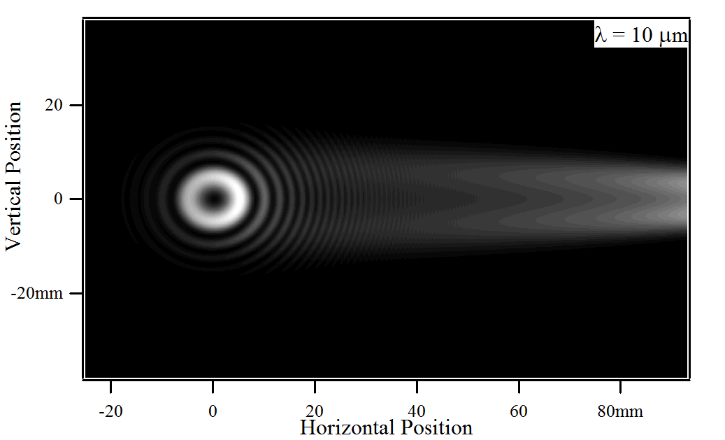
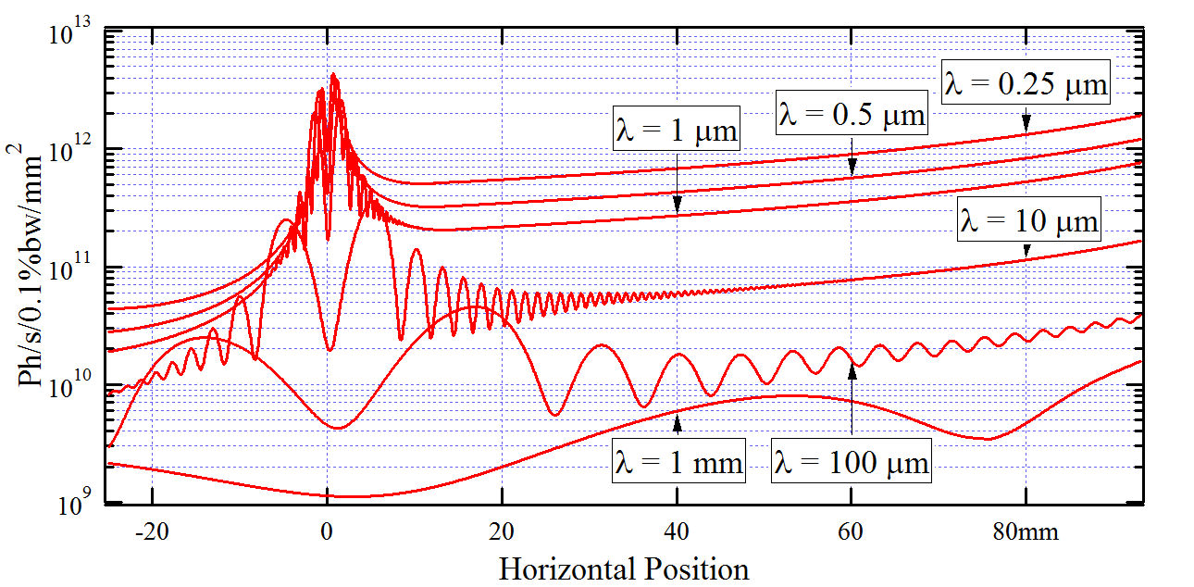
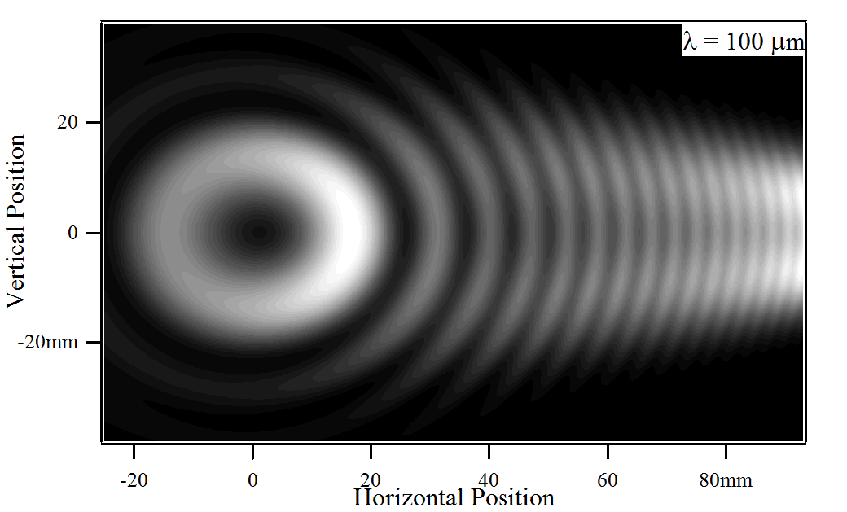
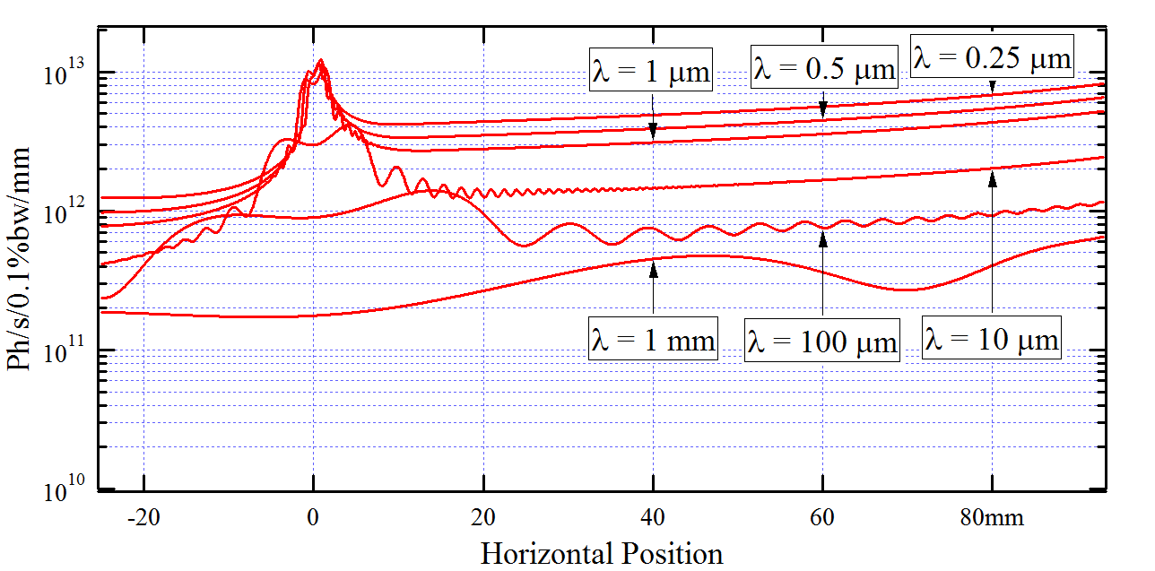
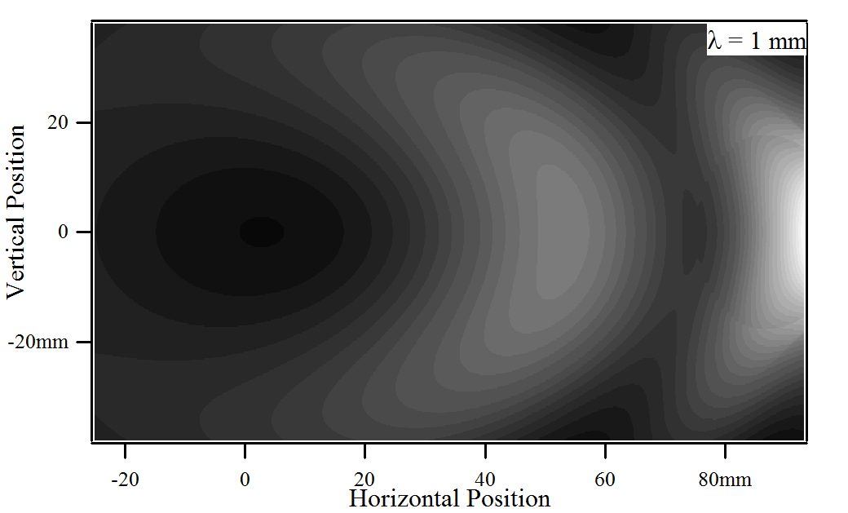
IR SR / ER Intensity Distributions in Transverse Plane at M1 of an Infrared Beamline of NSLS-II
B = 0.4 T; Collection Aperture: ~50 mrad (h) x 35 mrad (v)
Intensity Cuts by the Horizontal Median Plane
F = 2.0x10¹⁴ ph/s/.1%bw
Intensity Profiles (obtained by integration of 2D distributions over vertical position within M1)
F = 1.0x10¹⁴ ph/s/.1%bw
Similar IR beamlines exist at ANKA, ESRF, SOLEIL, Jlab NSLS-II version will offer higher flux (because of lower field in BM and larger vertical aperture)
F = 3.8x10¹³ ph/s/.1%bw
P. Dumas (SOLEIL), R. Carr, L. Miller (BNL)

Slide 9
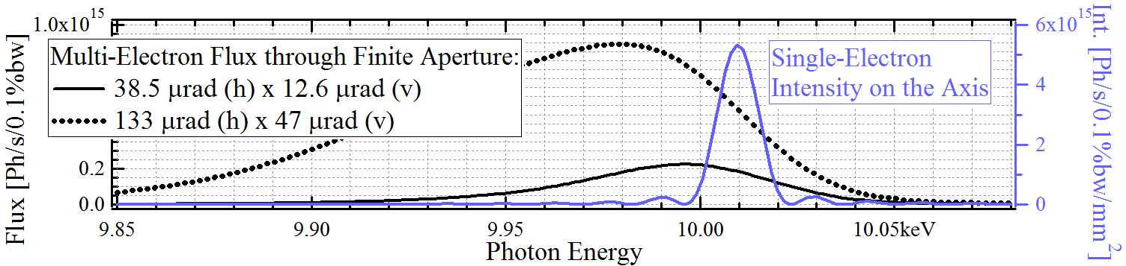
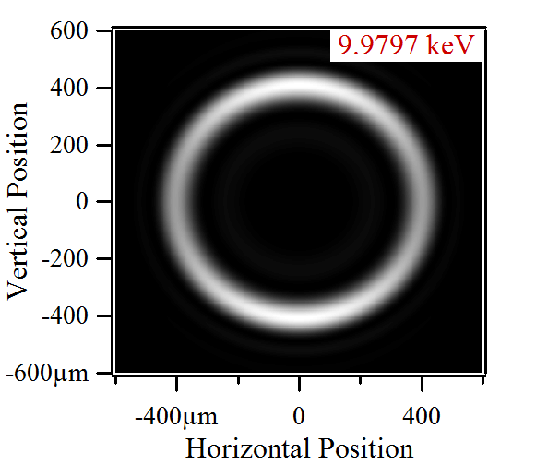
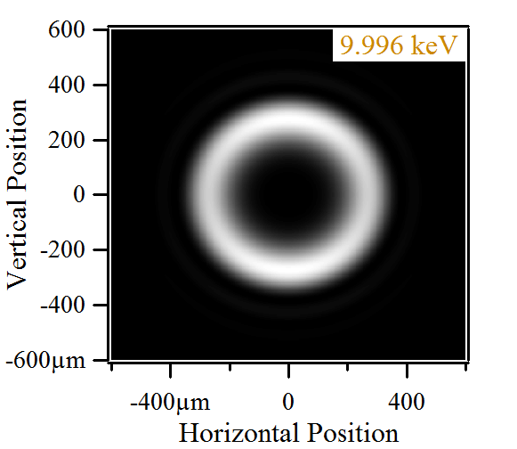
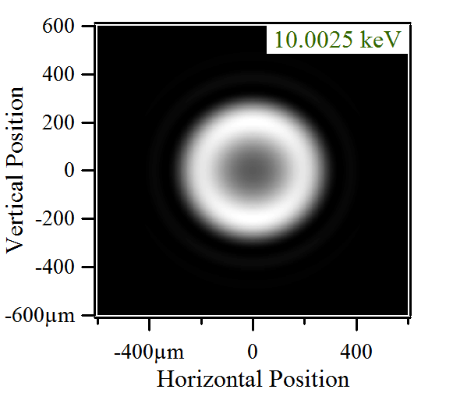
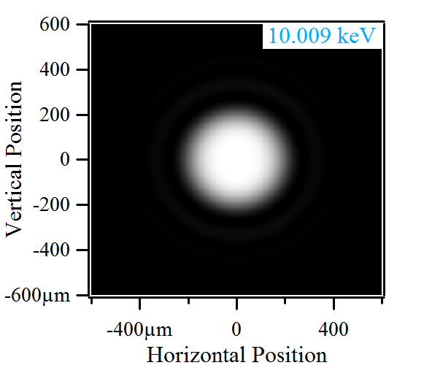
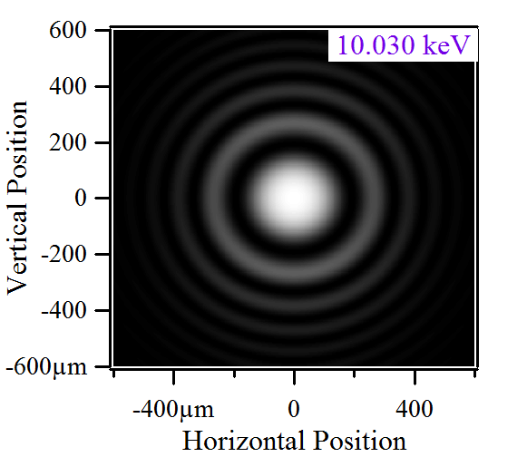
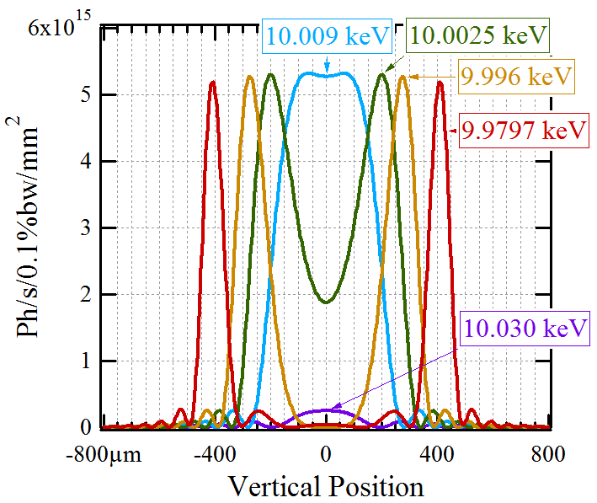
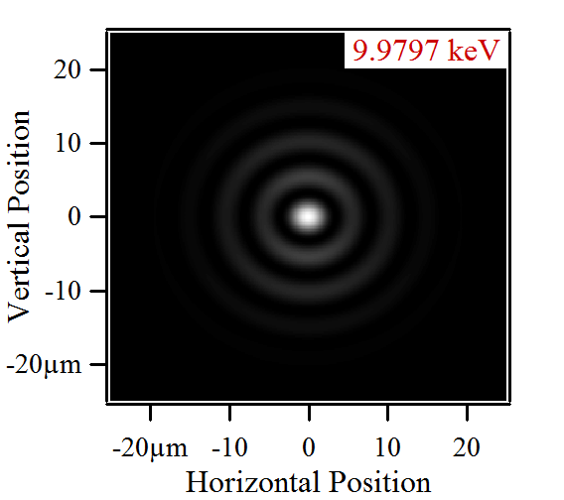
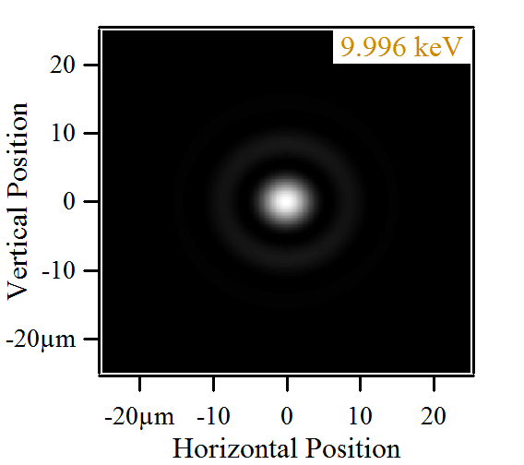
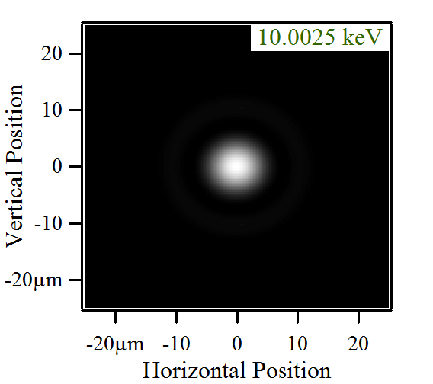
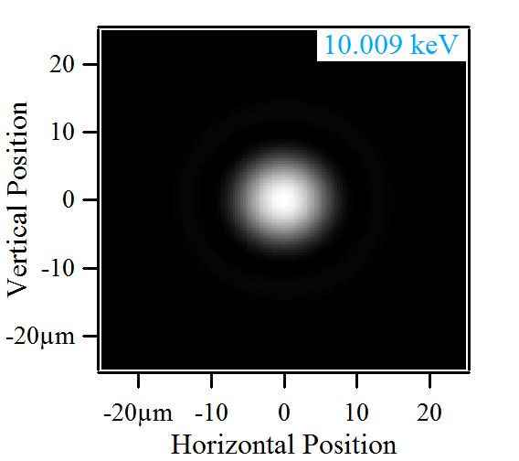
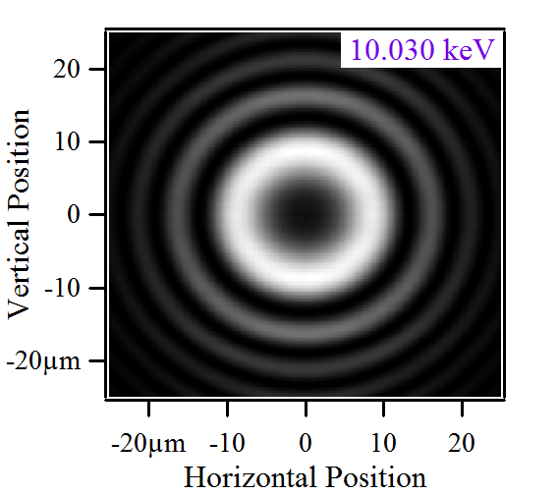
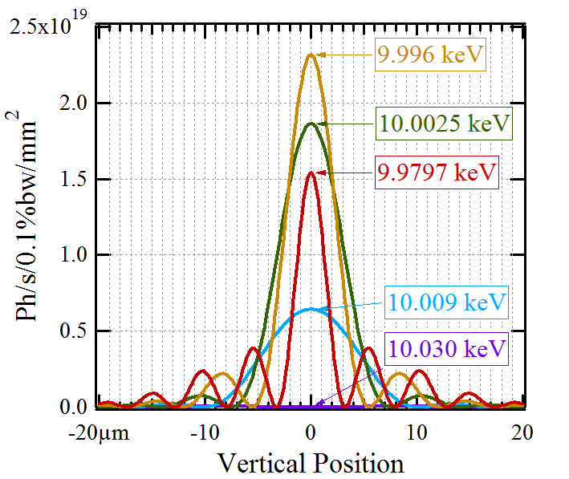
Single-Electron (Fully Transversely-Coherent) UR Intensity Distributions “in Far Field” and “at Source”
UR “Single-Electron” Intensity and “Multi-Electron” Flux
Undulator
Ideal Lens
1:1 Image Plane
E-Beam Energy: 3 GeV Current: 0.5 A
Undulator Period: 20 mm
H5
Intensity Distributions at 30 m from Undulator Center
Vertical Cuts (x = 0)
Intensity Distributions in 1:1 Image Plane
“Phase-Space Volume” Estimation for Vertical Plane (RMS sizes/divergences calculated for the portions of intensity distributions containing 95% of flux)

Slide 10
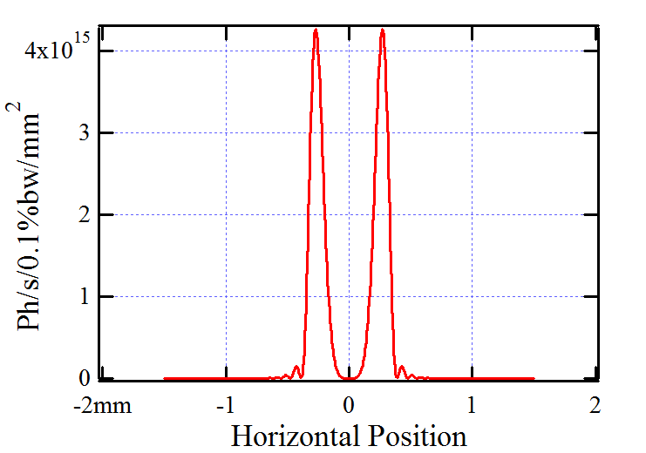
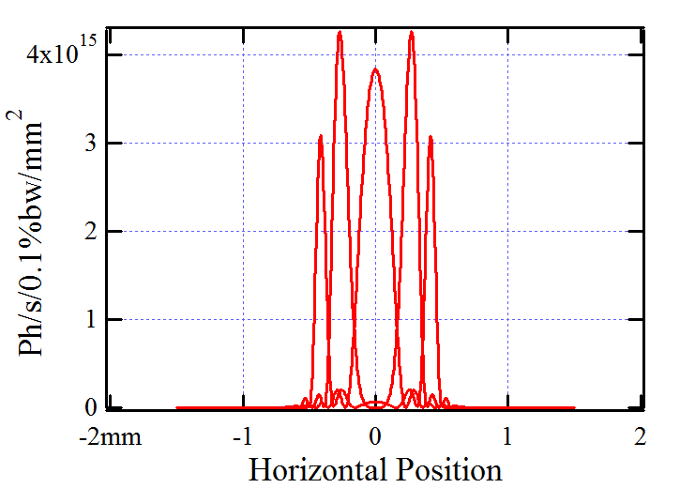
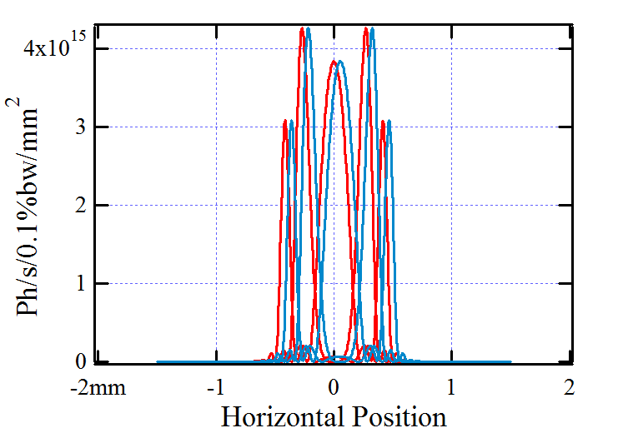
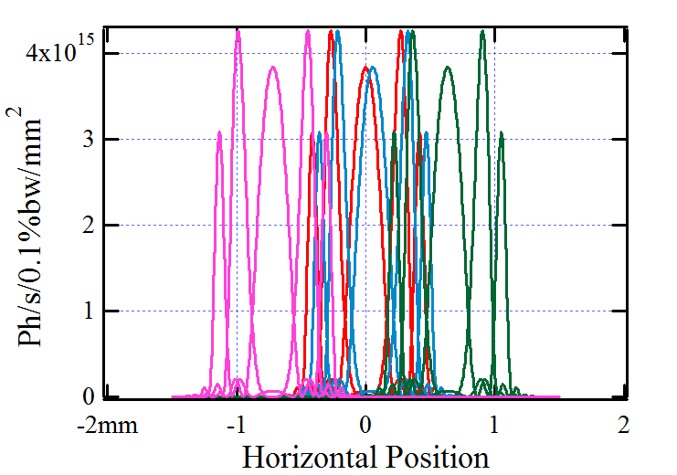
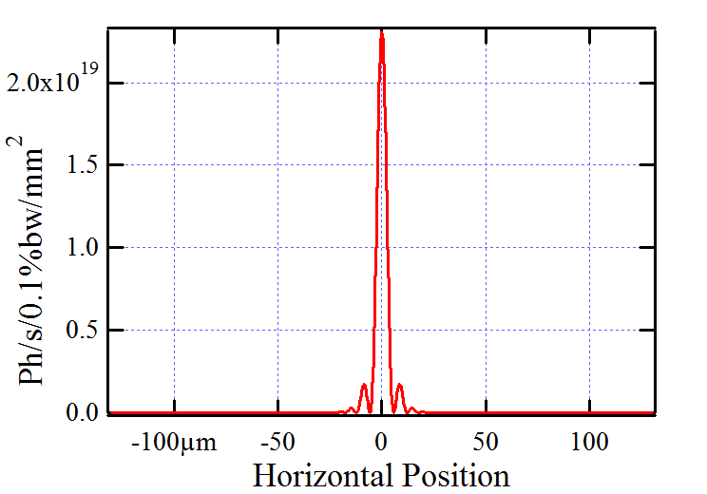
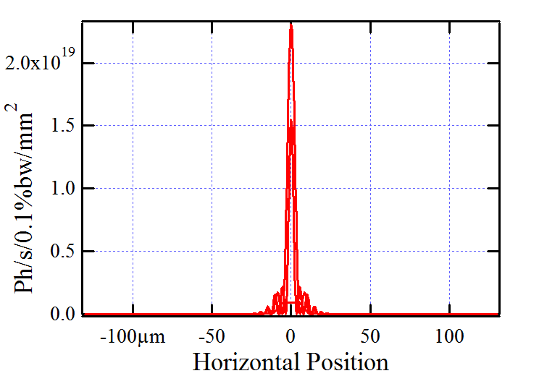
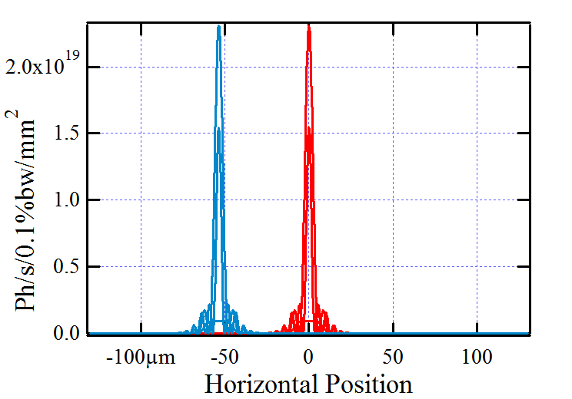
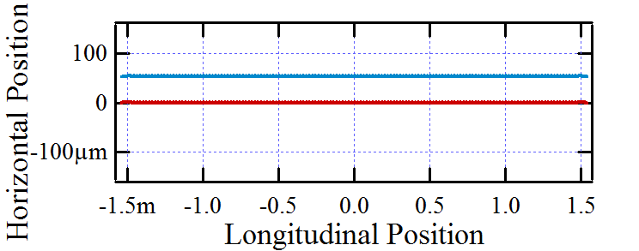
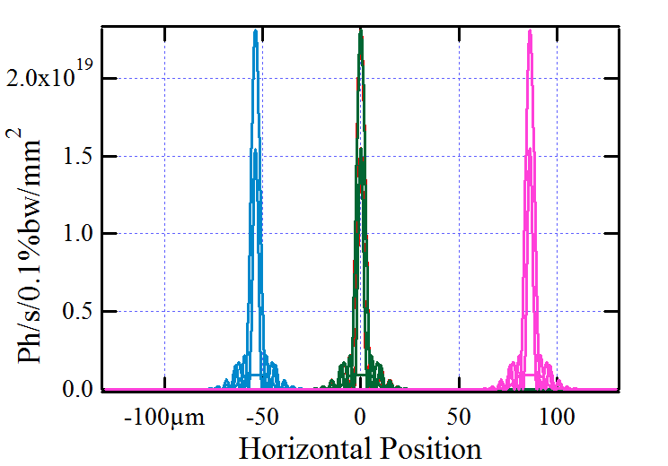
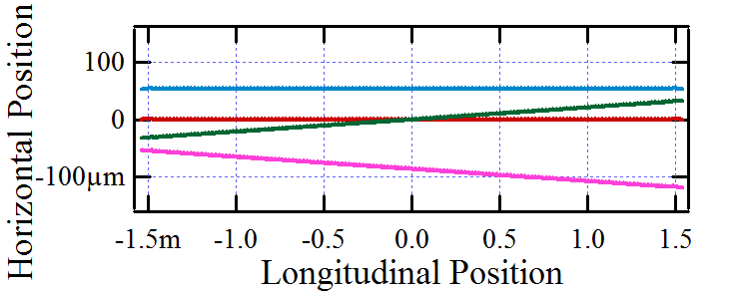
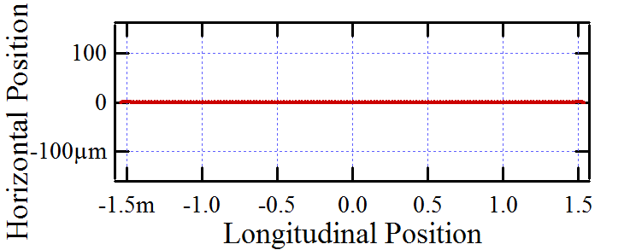
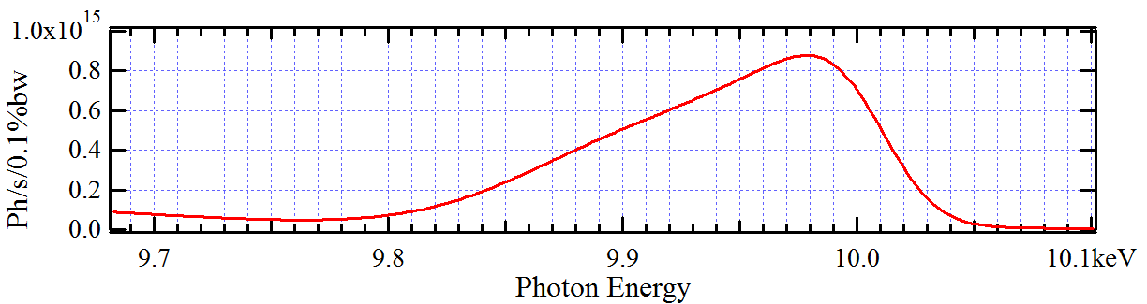
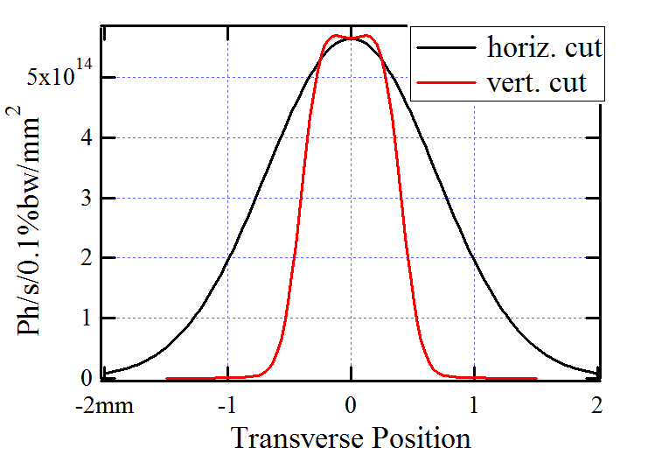
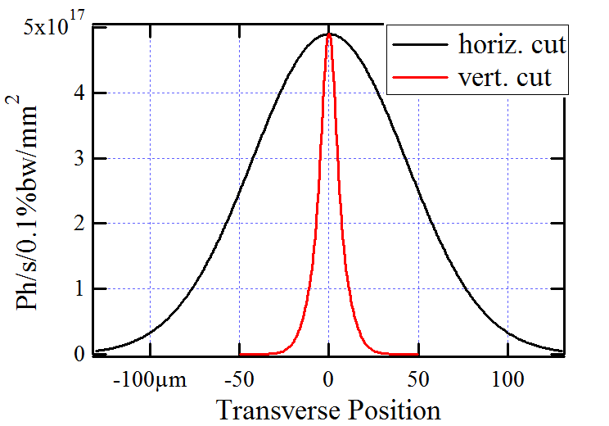
Formation of Intensity Distribution of Partially-Coherent Spontaneous SR after Propagation through a Beamline in a 3rd Generation Source
Undulator
Lens
Image Plane
Electron Trajectories
“Single-Electron” Intensity Distributions (Horizontal Cuts)
In Lens Plane (at 30 m)
In 1:1 Image Plane
UR Spectrum
through 100 μrad (H) x 50 μrad (V) Ap.
at K~1.5 providing H5 peak at ~10 keV
“Multi-Electron” Intensity Distributions (Horizontal Cuts)

Slide 11
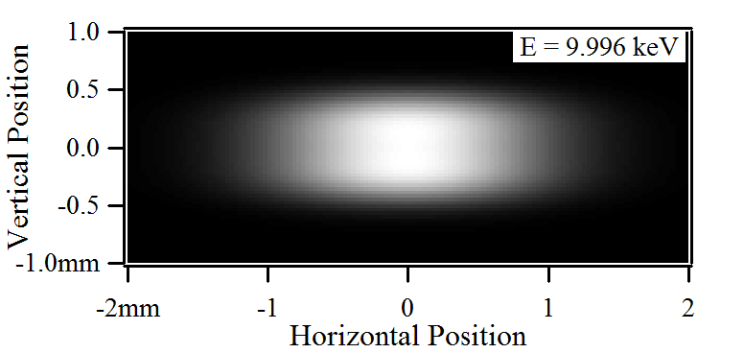
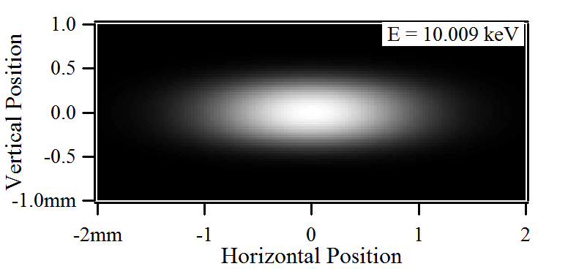
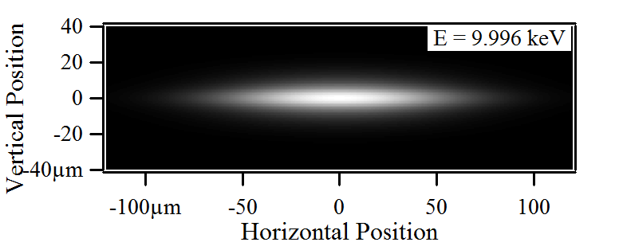
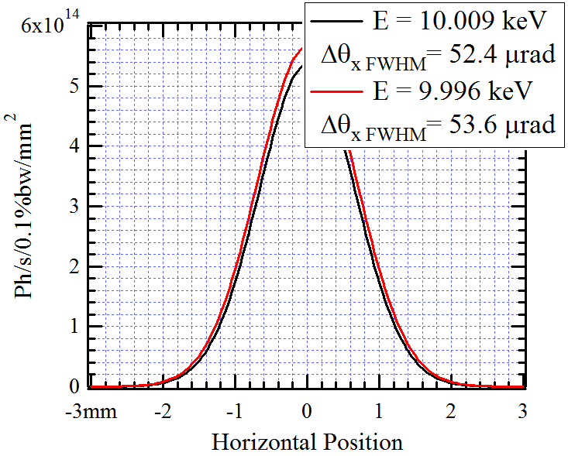
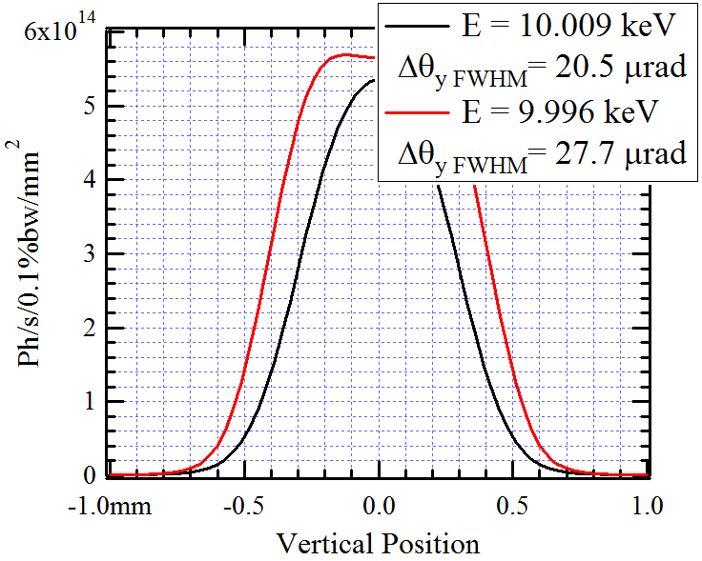
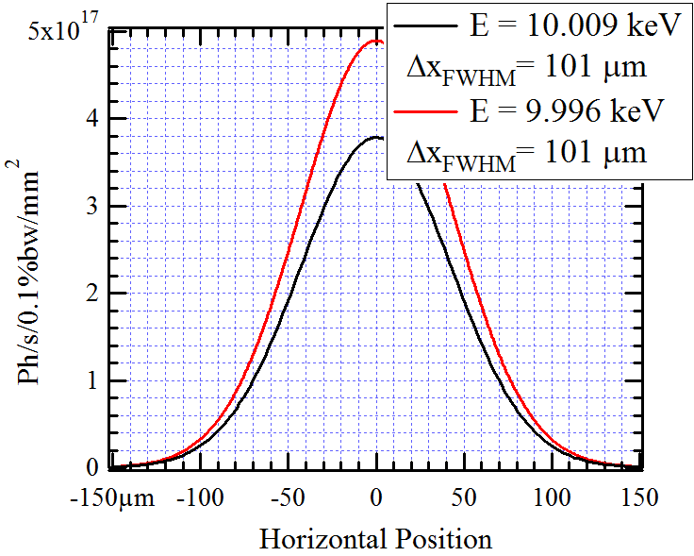
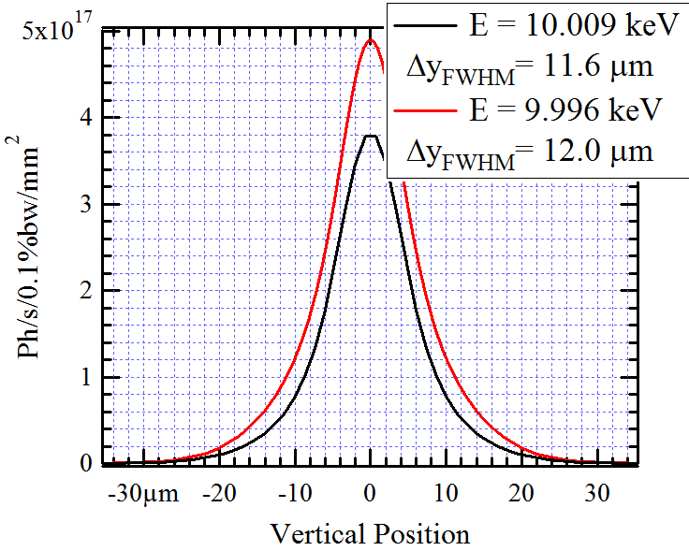
Estimation of X-Ray Beam Angular Divergence and Source Size by Wavefront Propagation
IVU20-3m Spectral Flux through 100 μrad (H) x 50 μrad (V) Aperture
at K~1.5 providing H5 peak at ~10 keV
Test Optical Scheme
Electron Beam:
Hor. Emittance: 0.9 nm
Vert. Emittance: 8 pm
Energy Spread: 8.9x10⁻⁴
Current: 0.5 A
Low-Beta Straight
IVU20
Ideal Lens
1:1 Image Plane
Intensity Distributions at ~10 keV
At 30 m from Undulator
In 1:1 Image Plane
Horizontal Cuts (y = 0)
Vertical Cuts (x = 0)
Horizontal Cuts (y = 0)
Vertical Cuts (x = 0)
…very far from Coherent Gaussian Beam !

Slide 12
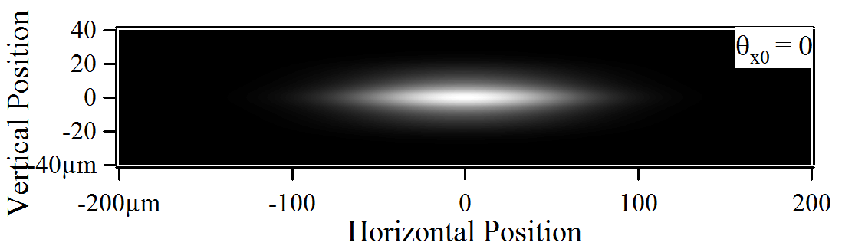
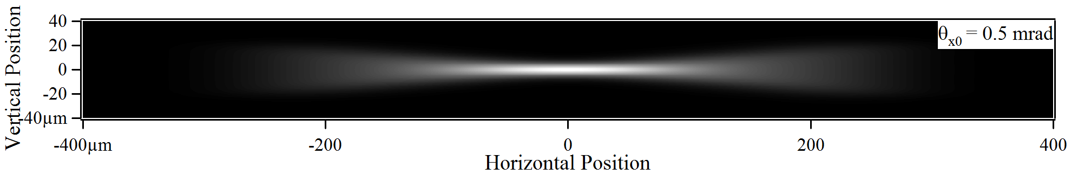



Intensity Distributions of Focused Wiggler Radiation from Partially-Coherent Wavefront Propagation Calculations
On-Axis Collection: θ_{x0}= 0, θ_{y0}= 0 |θ_{x} - θ_{x0} |< 0.1 mrad |θ_{y} - θ_{y0} |< 0.1 mrad
1 : 1 Imaging Scheme with “Ideal Lens”
Off-Axis Collection: θ_{x0}= 0.5 mrad, θ_{y0}= 0
θ_{x0}= 1 mrad, θ_{y0}= 0
Horizontal Cuts (y = 0)
Vertical Cuts (x = 0)
NSLS-II Low-Beta Straight Section
I = 0.5 A, ε_{x}= 0.9 nm, ε_{y}= 8 pm
SCW40: λ_{u}= 40 mm, B_{max}= 3 T, L = 1 m
Photon Energy: E_{ph}= 10 keV

Slide 13
NSLS-II Hard X-Ray Nanoprobe (HXN) Beamline Conceptual Optical Scheme
IVU20
HCM
MONO
HFM
Horizontal Plane
SSA
N.O.:
ZP
or
MLL
Sample Plane
0 m
20 m
40 m
60 m
80 m
100 m
VFM or CRL
Vertical Plane
Y. Chu, H. Yan, K. Kaznatcheev
Approximations Used to Simulate Optical Elements:
Horizontal Collimating, Horizontal Focusing and Vertical Focusing Mirrors (HCM, HFM and VFM respectively), and Nanofocusing Optics (N.O.) simulated by “Ideal” Lenses.
Geometrical Apertures of all Mirrors, the Secondary Source Aperture (SSA), and the N.O. are carefully respected.
Monochromator (MONO) was assumed to be “Ideal”.
Such approximations were used purposely, in order to "observe" pure effects related to partial coherence of the source, and to trace losses on apertures.
Two possible SSA locations: at ~62 - 65 m and at ~92 - 94 m from undulator.
Two N.O. cases: F = 18.14 mm, D = 150 μm; and F = 42.33 mm, D = 350 μm (Δr ≈ 15 nm in both cases); E_{ph}≈ 10 keV

Slide 14


Intensity Distributions at Different Locations
Option with Secondary Source at 62 m
of HXN Beamline
At HCM (~27 m)
I_{e} = 0.5 A
E_{ph}≈ 10 keV
5th harmonic of IVU20 at K ≈ 1.5
Flux after HCM: ~7.4x10¹⁴ ph/s/.1%bw
Option with Secondary Source at 94 m
At SSA (~62 m)
At SSA (~94 m)
Flux after SSA (Δx_{ss}=50 μm): ~2.9x10¹⁴ ph/s/.1%bw
Flux after SSA (Δx_{ss}=12 μm, Δy_{ss}=16 μm): ~1.7x10¹³ ph/s/.1%bw
At Nanofoc. Optics (~105 m)
At Nanofoc. Optics (~109 m)
Flux within N.O. Aperture (d=150 μm): ~2.0 x10¹² ph/s/.1%bw
Flux within N.O. Aperture (d=150 μm): ~3.6 x10¹² ph/s/.1%bw
At Sample (F_{N.O.}=18.14 mm)
At Sample (F_{N.O.}=18.14 mm)

Slide 15




Intensity Distributions at Sample for Different Secondary Source Aperture Sizes at HXN (NSLS-II)
In Horizontal Median Plane (y = 0)
For Different Horizontal SSA Sizes (Δx_{ss})
For Different Vertical SSA Sizes (Δy_{ss})
In Vertical Median Plane (x = 0)
For Nanofocusing Optics with F = 18.14 mm, D = 150 μm (Δr ≈ 15 nm; E_{ph}≈ 10 keV) SSA located at 94 m, Nanofocusing Optics at 109 m from Undulator

Slide 16


Final Focal Spot Size and Flux vs Secondary Source Aperture Size (HXN, NSLS-II)
Horizontal Spot Size and Flux
vs Horizontal Secondary Source Aperture Size
Vertical Spot Size and Flux
vs Vertical Secondary Source Aperture Size
Spot Size
Spot Size
Flux
Flux
Δy_{ss}= 30 μm
Δx_{ss}= 20 μm
Secondary Source Aperture located at 94 m from Undulator
Spot Size and Flux calculated for Nanofocusing Optics simulated by Ideal Lens with F = 18.14 mm, D = 150 μm located at 15 m from Secondary Source (109 m from Undulator)

Slide 17

NSLS-II SRX Beamline Conceptual Optical Scheme
2 operation modes with 2 sets of KB’s:
High flux mode (with large mirrors)
High resolution mode (diffraction limited)
J. Thieme V. DeAndrade

Slide 18





Preliminary Partially-Coherent Wavefront Propagation Simulation Results for SRX: Imperfect K-B Mirrors (I)
Intensity Distributions “at Sample” at 200 μm Size of Secondary Source Aperture
Imperfect Mirror Height Profiles
Perfect Optics (Ideal Lenses)
Imperfect Optics
Horizontal Cuts
Vertical Cuts
V. DeAndrade

Slide 19




Preliminary Partially-Coherent Wavefront Propagation Simulation Results for SRX: Imperfect K-B Mirrors (II)
Intensity Distributions “at Sample” at 15 μm Size of Secondary Source Aperture
Imperfect Mirror Height Profiles
Perfect Optics (Ideal Lenses)
Imperfect Optics
Horizontal Cuts
Vertical Cuts
V. DeAndrade

Slide 20






Intensity Distributions at Sample Taking Into Account Ellipsoidal Shapes and Slope Errors of KB Mirrors
IVU21
Horizontal Plane
HFM
SSA
KB
KB simulated using Grazing-Incidence “Thick Optical Element” Propagator based on Local Ray-Tracing.
KB Surface Height Error simulated by corresponding Phase Shifts (“Masks”) in Transverse Plane at Mirror Locations.
FMX (PX) Beamline
0 m
20 m
40 m
60 m
Sample Plane
Vertical Plane
Horizontal SSA Size: 30 μm
Photon Energy: 12.7 keV
Flux at Sample: ~5.4x10¹³ ph/s/.1%bw
Horizontal Cuts (y = 0)
Vertical Cuts (x = 0)
Without Mirror Surface Slope (/Height) Errors
With Mirror Surface Slope (/Height) Errors

Slide 21




Using CRLs for Producing “Large Spot” at Sample (taking into account Mirror Shape and Slope Error)
IVU21
Horizontal Plane
HFM
SSA
CRL
KB
Source:
Electron Current: 0.5 A
Horizontal Emittance: 0.55 nm (“ultimate”)
Vertical Emittance: 8 pm
Undulator: IVU21 – 1.5 m centered at +1.25 m from Low-Beta Straight Section Center
FMX (PX) Beamline
0 m
20 m
40 m
60 m
Sample Plane
Vertical Plane
Intensity Distributions at Sample
Horizontal SSA Size: 30 μm
Photon Energy: 12.7 keV
Without Mirror
Slope
Errors
With Mirror
Slope
Errors
CRL “Transfocator”:
8 Horizontally + 3 Vertically-Focusing Be Lenses
R_{min} = 200 μm F_{h}≈ 5.9 m, F_{v} ≈ 15.8 m
Geom. Ap.: 1 mm x 1 mm
Located at 0.75 m before VKB edge
(10 m after SSA)
Flux Losses at CRL: ~1.6 times
hor. cuts (y = 0)
vert. cuts (x = 0)

Slide 22

NSLS-II Coherent Hard X-Ray (CHX) Beamline Conceptual Optical Scheme
A. Fluerasu, L. Wiegart, K. Kaznatcheev, L. Berman

Slide 23












Partially-Coherent Wavefront Propagation Calculations for CHX
(I)
Intensity Distributions in the Case of: ΔS_{1x}= 44 μm, ΔS_{1y}= 250 μm
Before SS1 (@33.5 m)
Before CRL
(@35.3 m)
Before KL
(@44 m)
At Sample
(@48.5 m)
E=10 keV
Be 1D CRL: N = 9, A_{geom}= 1 mm
R_{min}= 0.5 mm, F_{y}= 8.152 m
F_{KLx}≈ 3.5 m
Flux: 4x10¹³ ph/s/.1%bw
Vertical Cuts
Horizontal Cuts

Slide 24











Partially-Coherent Wavefront Propagation Calculations for CHX
(II)
Intensity Distributions in the Case of: ΔS_{1x}= 44 μm, ΔS_{1y}= 100 μm
Before SS1 (@33.5 m)
Before CRL
(@35.3 m)
Before KL
(@44 m)
At Sample
(@48.5 m)
E=10 keV
After 2 Slits placed at Sample
Observation in Far Field Slit Size: 1 μm
Be 1D CRL: N = 9, A_{geom}= 1 mm
R_{min}= 0.5 mm, F_{y}= 8.152 m
F_{KLx}≈ 3.5 m
Flux: 1.6x10¹² ph/s/.1%bw
Vertical Cuts
h_{y}= 14 μm
Horizontal Cuts
h_{x}= 8 μm

Slide 25












Partially-Coherent Wavefront Propagation Calculations for CHX
(III)
Before CRL
(@35.8 m)
Intensity Distributions in the Case of: ΔS_{1x}= 44 μm, ΔS_{1y}= 1 mm
E=10 keV
Before SS1 (@33.5 m)
Before KL
(@44 m)
At Sample
(@48.5 m)
After 2 Slits placed at Sample
Observation in Far Field Slit Size: 1 μm
h_{y}= 15 μm
Intensity Distributions along Beam Path
At Slit “Image”
Be 1D CRL: N = 8, A_{geom}=1 mm
R_{min}= 0.5 mm, F_{y}= 9.171 m
F_{KLx}≈ 3.5 m
Flux: 10¹³ ph/s/.1%bw
Vertical Cuts
h_{y}= 10 μm
Horizontal Cuts
h_{x}= 8 μm

Slide 26





Partially-Coherent Wavefront Propagation Calculations for CHX
(IV)
Diffraction / Scattering from Test Sample
5000 “Silica Spheres”, d ≈ 200 nm
Sample data from Andrei Fluerasu
Angular Distribution of Scattered X-Rays at E=10 keV
ΔS_{1x}= 44 μm ΔS_{1y}= 100 μm
ΔS_{1x}= 44 μm ΔS_{1y}= 1 mm

Slide 27
Optical Scheme of Wavefront Preservation Test Experiments with CRL and a Boron Fiber Probe
APS, Dec. 2011
1D Be CRL
1 – 5 lenses R_{min} = 500 μm
D = 1 mm
Detector
YAG + CCD
U33 (APS 32ID)
Mono
E_{ph} = 8.5 keV
B-Fiber
D = 100 μm
0 lenses
1 lens
2 lenses
3 lenses
~1.25 m from
from center of straight section
4 lenses
5 lenses
~36 m
~71 m
~75 m
V. Kohn, I. Snigireva and A. Snigirev, “Direct measurement of transverse coherence length of hard X-rays from interference fringes”, Phys. Rev. Lett., 2000, vol.85(13), p.2745.
A. Snigirev, V. Kohn, I. Snigireva, B. Lengeler, “A compound refractive lens for focusing high-energy X-rays”, Nature, 1996, vol.384, p.49.
New generation CRL from B. Lengeler et al.

Slide 28

























Intensity Distributions in B-Fiber Based Interference Scheme for Different Numbers of CRL in Optical Path
no lenses
1 lens
2 lenses
3 lenses
4 lenses
5 lenses
Measurement
vertical cuts (at x = 0)
Calculation
vertical cuts (at x = 0)

Slide 29






Simulations for FEL:
SASE Pulse Profiles and Spectra at FEL Exit
E-Beam:
E = 1 GeV σ_{t e} ~ 200 fs
I_{peak} = 1.5 kA ε_{x} = ε_{y} = 1.2 π mm-mrad
Undulator:
K ~ 2.06
λ_{u} = 30 mm
L_{tot} ~ 5 x 2 m
GENESIS
(integrated to SRW)
P_{max ssed} ~ 50 kW
σ_{t seed} ~ 25 fs
A: Seeded FEL operation
= 100.15 eV
Peak Power vs Long. Position
Power vs Time
Energy Spectrum
B: SASE (not saturated)

Slide 30






Simulations for FEL:
SASE Intensity Distributions at FEL Exit
GENESIS
(integrated to SRW)
A: Seeded FEL operation
Power Density Cuts at Pulse Center
Peak Spectral Fluence Transverse Cuts
Fluence
B: SASE (not saturated)

Slide 31










Time-Dependent FEL Wavefront Propagation Simulation: Pulse Characteristics in Image Plane of a 2-Slit Interferometer with a Grating
E-Beam:
E = 1 GeV σ_{t e} ~ 200 fs, ε_{x} = ε_{y} = 1.2 π mm-mr
I_{peak} = 1.5 kA
Undulator:
λ_{u} = 30 mm, L_{tot} ~ 5 x 2 m, K ~ 2.06
Power Density vs Time and Vertical Position (at x = 0)
Grating
Slits
M1
A: Seeded
FEL
Image
Plane
Spectral Fluence vs Photon Energy and Vertical Position (at x = 0)
Fluence (Time-Integrated Intensity)
vs Horiz. and Vert. Positions vs Vert. Position (at x = 0)
Power vs Time
B: Started from noise
Reduction of processing time is possible by using In-Place FFTs on GPU systems with common memory.
GENESIS + SRW, FEL Frontiers - 2007

Slide 32



Extension of Hartmann Wavefront Sensor Method To Probe Transverse Coherence Over Wavefront
Measurements in Single-Shot Regime at SCSS Test Accelerator FEL
M.-E. Couprie
M. Idir
P. Mercier
R. Bachelard
M. Labat
T. Hara
et al.
At Fundamental Harmonic
Measured
Simulated
Diffraction Pattern from One Rectangular Tilted Hole at 3rd Nonlinear Harmonic
Simulated
SASE (Genesis) + Wavefront Propagation (SRW)
Simulated
Point Source
(analytical model)
Measured
R. Bachelard et.al., PRL 106, 234801 (2011)

Slide 33
SRW Project Status (as of May 2013)
“Synchrotron Radiation Workshop” (SRW) is electrodynamics / physical optics computer code for calculation of Synchrotron Radiation and simulation of Fully- and Partially-Coherent Radiation Wavefront Propagation
SRW is written essentially in ANSI C++; C API is available (compiles as a 32- or 64-bit static or shared library for Windows, Linux, Mac OSX)
Versions interfaced to IGOR Pro for Windows and Mac are available since 1997: http://www.esrf.eu/Accelerators/Groups/InsertionDevices/Software/SRW
SRW for Python (2.7 and 3.2, 32- and 64-bit) versions are available for Windows and Linux since 2012
Parallel versions of SRW for Python are available for partially-coherent wavefront propagation simulations (two test implementations: based on MPI / mpi4py, and using data exchange via files)
SRW has been recently released to the Open Source under BSD-type license (the release procedure has been completed at BNL; permissions for the release were obtained from all Contributed Institutions and from US DOE): https://github.com/ochubar/SRW
Institutions and Individuals Contributed to SRW project: - ESRF: P.Elleaume, O.Chubar (O.C.), J.Chavanne, N.Canestrari (N.C.), M.S.del Rio - SOLEIL: O.C. - BNL / PS: O.C., N.C., R.Reininger (R.R.) - E-XFEL GmbH: L.Samoylova, G.Geloni, A.Buzmakov, I.Agapov - DIAMOND LS Ltd.: J.Sutter, D.Laundy, K.Sawhney - ANL / APS: R.R.
On-going developments: - “thick” optical elements and library of mirror surfaces (under benchmarking); - X-ray diffraction by perfect crystals in Bragg and Laue geometries; - improving efficiency of 3D time (/frequency) dependent simulations for X-ray FEL and short-pulse THz–IR applications; - facilitating inter-operation with SHADOW ray-tracing code and other software

Slide 34
SRW Applications (Summary)
Accurate calculation of Electric Field and other characteristics of Synchrotron Radiation and simulation of Fully- and Partially-Coherent Wavefront Propagation within the framework of Physical Optics, implemented in SRW computer code, allows for a large variety of applications in such areas as:
Development of New and Improvement of Existing Synchrotron Radiation Sources
Optimization of SR Beamlines for most efficient use of the properties of Sources and Optical Elements
Development of New types of Optical Elements for 3rd and 4th Generation Synchrotron Sources
Electron Beam, Insertion Device and Optical Element Characterization and Diagnostics
Simulation of User Experiments for most efficient use of Beam Time
Potentially: use of SRW functions for Data Processing in Experiments in such areas as Imaging and Microscopy

Slide 35
Acknowledgements
J.-L. Laclare, P. Elleaume
A. Snigirev, I. Snigireva, J. Susini, M. Sanchez del Rio, J. Chavanne (ESRF)
S. Molodtsov, L. Samoylova, G. Geloni, A. Buzmakov, I. Agapov, M. Yurkov, E. Saldin (European X-FEL / DESY)
G. Materlik, K. Sawhney, J. Sutter, D. Laundy (DIAMOND)
P. Dumas, M.-E. Couprie, P. Roy (SOLEIL)
G. P. Williams (JLab)
Y.-L. Mathis, P. Rieger (ANKA)
V. Yashchuk, N. Artemiev, D. Robin, D. Shapiro (LBNL)
R. Reininger, A. Khounsary, A. Zholents, Y. Shvydko (ANL)
N. Smolyakov, S. Tomin (Kurchatov Inst.)
J. Bahrdt (BESSY)
S. Dierker, Q. Shen, L. Berman, S. Krinsky, M. Idir, T. Shaftan, A. Fluerasu, L. Wiegart, K. Kaznatcheev, V. DeAndrade, Y. Chu, N. Canestrari, G. Bassi, A. Suvorov, P. Ilinski, V. Litvinenko (BNL)

Slide 36
SPARE SLIDES

Slide 37
Spontaneous Emission by Relativistic Electron in Free Space
Lienard-Wiechert Potentials for One Electron moving in Free Space:
(Gaussian CGS)
⇓
Electric Field in Frequency Domain (exact expressions!):
I.M.Ternov
used this approach in Far Field
J.D.Jackson
The equivalence of the two expressions can be shown by integration by parts
Phase Expansion (valid for the Near Field and in the Far Field Observation Conditions):
are 2D vectors defining transverse coordinates and angles of electron trajectory
is a 2D vector defining transverse coordinates of observation point
is longitudinal coordinate of observation point

Slide 38
Wavefront Propagation in the Case of Full Transverse Coherence
Kirchhoff Integral Theorem applied to Spontaneous Emission by One Electron
Σ
V
e
-
P₂ (x₂,y₂,z₂)
P_{e} (x_{e},y_{e},z_{e})
A
Valid at large observation angles;
Is applicable to complicated cases of diffraction inside vacuum chamber
Z
R
S
Y
P₁ (x₁,y₁,z₁)
X
Huygens-Fresnel Principle
Fourier Optics
Free Space:
(between parallel planes perpendicular to optical axis)
Assumption of small angles
“Thin” Optical Element:
“Thick” Optical Element:
(from transverse plane before the element to a transverse plane immediately after it)
E.g. from Stationary Phase method

Slide 39
Incoherent and Coherent Spontaneous Emission by Many Electrons
Electron Dynamics:
← Initial Conditions
Spectral Photon Flux per unit Surface emitted by the whole Electron Beam:
“Incoherent” SR
↓
↑
Coherent SR
Common Approximation for CSR: “Thin” Electron Beam:
For Gaussian Longitudinal Bunch Profile:
If
is Gaussian, 6-fold integration over electron phase space can be done
analytically for the (Mutual) Intensity of Incoherent SR and for the Electric Field of CSR

Slide 40
Partially-Coherent SR Wavefront Propagation
Averaging of Propagated One-Electron Intensity over Phase-Space Volume occupied by Electron Beam:
Convolution is valid in simple cases:
- projection geometry;
- focusing by a thin lens;
- diffraction on one slit (/pinhole);
- …
OR:
Propagation of Mutual Intensity
Initial Mutual Intensity:
Wigner Distribution (or mathematical Brightness):

Slide 41





Intensity Distributions of Focused Wiggler Radiation (1 : 1) Wavefront Propagation Calculations for “Filament” Electron Beam
1) On-axis collection (at θ_{x0}= 0):
-0.05 mrad < θ_{x} < 0.05 mrad
-0.05 mrad < θ_{y} < 0.05 mrad
Horizontal Cuts (y = 0)
Magnetic Field
Δx ≈ 24 μm
2) Off-axis collection at θ_{x0}= 0.5 mrad: 0.45 mrad < θ_{x} < 0.55 mrad
-0.05 mrad < θ_{y} < 0.05 mrad
Electron Trajectory
~ λ_{u}θ_{x0}
Δx ≈ 24 μm
λ_{u}= 40 mm
3) Off-axis collection at θ_{x0}= 1 mrad:
0.95 mrad < θ_{x} < 1.05 mrad
-0.05 mrad < θ_{y} < 0.05 mrad
~ λ_{u}θ_{x0}
E-beam: E = 3 geV, I = 0.5 A
SCW40: λ_{u}= 40 mm, B_{max}= 3 T, L = 1 m
Photon Energy used in calc.: E_{ph}= 10 keV

Slide 42
Features of Some Existing Free Computer Codes
Features \ Codes | SPECTRA | WAVE | GENESIS | SHADOW | RAY | PHASE | SRW
Source Simulation Gaussian Beams Spontaneous SR Single-Electron Incoherent “Multi-Electron” CSR SASE | Y Y Y Y Y Y(?) N | Y Y Y Y Y(?) Y(?) N | Y Y N(?) N(?) N(?) N(?) Y | Y(?) Y Y (BM?) N Y (BM?) N N | N(?) Y N(?) N(?) N(?) N(?) N(?) | N(?) Y(?) N N N N N | Y Y Y Y Y Y N(?)
Geometrical Ray-Tracing | N | N | N | Y | Y | N | N
Wavefront Propagation Fully-Coherent Beams Partially-Coherent Beams Time-/Frequency-Dependent | N(?) | N | N(?) | N | N(?) | Y Y N(?) Y(?) | Y Y Y Y
Optical Elements Grazing-Incidence Mirrors Refractive Optics Diffractive Optics Gratings Crystals | N | N | N | Y Y Y N Y(?) Y | Y Y Y Y Y Y | Y Y Y Y(?) Y N(?) | Y Y(?) Y Y N(?) N(?)
Framework Scripting Environment File Input-Output GUI API Cross-Platform Open Source | Y N(?) Y Y(?) N(?) Y(?) N(?) | Y N(?) Y Y N(?) Y(?) N(?) | Y N(?) Y N(?) N(?) Y Y | Y Y(?) Y Y(?) N Y Y | Y N(?) Y Y N(?) Y N(?) | Y N(?) Y Y N(?) Y N | Y Y Y(?) Y(?) Y Y Y
Development Effort (man-years to date, full time) | ? | ? | ~4(?) | ~5(?) | ? | ~3(?) | ~4

Slide 43




Height Profiles and Slope Errors of Some Mirror
Height Profiles
Slope Errors
Long Mirror Considered for FMX BL Tests
Short Mirrors Considered for SRX BL Tests
Data from M. Idir, R. Sweet, V. DeAndrade (BNL), L. Samoylova (E-XFEL)

Slide 44


Non-Destructive Single-Shot E-Beam Emittance Measurement in ERL / FEL Injectors Using Interfering Edge Radiation
Image of PI camera,
filter: dλ = 10 nm at λ = 532 nm
e-beam:
E = 64 MeV
dE/E = 2e-4
Q = 500 pC
ε_{N} ≈ 2 μm
Simulation (SRW)
Measurement
V. Yakimenko, M. Fedurin (ATF, BNL, June 2012)
Method: O.C., Rev. Sci. Instrum., 1995, vol.66 (2), p.1872
(SRI-1994); “Siberia-1”, Kurchatov Institute, Moscow

