Slide 1

ESRF Vacuum Control System
Pascal Verdier
ISDD software group
4th of October 2010
Software Vocabulary
ESRF Accelerator Control System
TACO / TANGO
ESRF Vacuum Control System

Slide 2
Software Vocabulary
Class:
  A class is a software object modeling an object with an interface.
  Assembling classes as bricks will build a software program.
  In our control system, a class models a concrete object
  e.g.: a gauge, a controller, a serial line,…
  And the interface is defined by commands, attributes, properties,…
  It can also model an abstract object (e.g.: beam position or emittance)
Device:
  A device is an instance of a class. e.g.: pump1, pump2, pump3,…
  All devices of a class have the same commands, attributes, properties.
  Only the property values can be different to configure it.
Device Server:
  A device server is a process running on a machine containing one
  (or several) class(es).
  It takes the device and class list from the database.

Slide 3
Software Vocabulary
Client:
  A client is a remote software object connected on a (or several) device(s)
  It takes the device connection parameters from the database.
  It could be an application, a calculation program or a device (higher level).
Device oriented control system:
  Taco and Tango are device oriented control systems.
  That means :
    Objects known by clients are devices and a device name must be unique.
    Devices are seen as a black box, and all actions (get/set) are done by the interface.
    All devices have the same interface:
      A set of Commands
      A set of Attributes
      A set of Properties
      A set of States
Taco/Tango Convention:
  A device is defined by 3 fields domain / family / member
    domain : e.g.: sr, sy, id08,…
    family : e.g.: d-ct, v-pen,… (should represent the device class).
    member : e.g.: 1, 2, c01-1, … (make unique the device name)

Slide 4
Software Vocabulary
Tango database:
- Connection
- Configuration
Client
Client
Device Server
Class A
Class B
Device
Device
Device
Device
D1
D2
D1
D2

Slide 5
Accelerator Control System Layers
Display layer (15 hosts)
Linux worstations
few Windows PC
Mirrored
Disk array
Disk
server
Process layer (20 hosts)
Solaris + Linux servers (aries,etc…)
Windows servers
Hardware control layer (110 hosts)
VME, PCs,
Linux, Windows
Field layer Fbus, Serial lines, dedicated systems
Wago, G64, Liberas, PLC…

Slide 6
Accelerator Control System
Network infrastructure
Rest of the
world
Rest of the ESRF
Firewall
Router
CTRM network
Routers
technical network
WiFi network
Technical gallerie
technical network
technical network
technical networks

Slide 7
Accelerator – Beamline CS
Accelerator
Control system
One large system
requests
Read parameters
Control insertion devices
Opening/closing frontend
beamline
Control system
40 small systems
beamline
Control system
beamline
Control system
beamline
Control system
beamline
Control system
beamline
Control system
beamline
Control system
beamline
Control system
beamline
Control system
beamline
Control system
beamline
Control system
beamline
Control system

Slide 8
TACO / TANGO
We started in the beginning of the nineties with TACO (Telescope and Accelerator Control Object), a device oriented control system.
Taco allows to have classes in C (and later in C++).
Learn from imperfections and limitation
TANGO development (TACO New Generation Object), a new device oriented control system based on CORBA.
It is a Object oriented software. It allows to have classes in C++, Java and Python.

Slide 9
TANGO Control System
Main improvements with TANGO:
  Attributes are auto describing (description, label, units,…)
  Tango manage attribute polling, with time stamping and an history buffer.
  Tango allows 3 modes of communication:
    Synchronous calls
    Asynchronous calls
    Events (on period, on change, and for archive)
  Tango allows to use high level language (Java and Python) for GUI.
Tango proposes:
  A set of management tools (Astor/Starter).
  A Database browser (Jive)
  A class generator (Pogo)
  Generic tools (ATK viewer, ATKpanel) using auto-description.
Tango is developed incollaboration with:
  Soleil (France)
  Elettra (Italy)
  Alba (Spain)
  Petra III at Desy (Germany)
  Max IV (Sweden).

Slide 10
TANGO Devices
1 Device can also interface complex systems
  Hierarchical structure
Client
Client
TANGO Software Bus
Macro device: e.g. Accelerator
sub devices: e.g. powersupplies
sub devices: e.g. ADC, modbus…

Slide 11
TACO / TANGO
Main Problem:
All device servers cannot be re-written in TANGO in few days.
It takes years and we need to support TACO and TANGO on accelerator.

Slide 12
Vacuum Control System
5 years ago we start to move vacuum control to Tango to:
  Do diagnostics on vacuum:
    Display info about 700 pressures and 900 temperatures, 25 RGAs.
    An historic buffer:
    Use Tango polling on attribute (1 second) with a buffer depth of 1 hour.
    Quick view on problem if any.
    Foreseen possible problem coming soon.
  Write pressures in HDB with complex criteria:
    Use Tango polling on pressure attribute to compute criteria and send data to HdbAccess (Taco HDB) Tango device server if needed.
Now we are moving to a complete Tango vacuum control:
  All vacuum servers must be Tango servers.
  SrVac and SyVac applications must be re-written as Tango clients.
  Install Tango vacuum servers on beamlines.

Slide 13
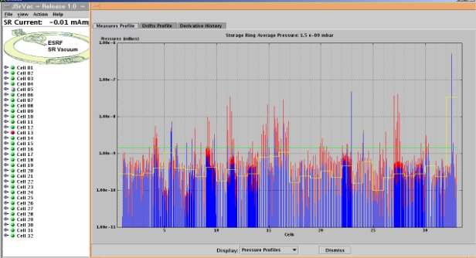
Vacuum Control System
Tango Spectrum
Attributes and
History
Taco Tango Pressures principle:
- 1 server for the storage ring (MultiCellGauges)
- 1 server for each cell (VacCellGauge)
- 1 server for 4or 6 physical devices (VacGauge)
Tango Spectrum Attributes
MultiCellGauges
VacCellGauge
VacCellGauge
VacCellGauge
32 Servers
Tango Scalar Attributes
VacGauge
VacGauge
VacGauge
VacGauge
145 Tango servers
Taco server
Taco server
Taco server
Taco server
Balzers
Balzers
VIP
VIP
~ 100 Balzers Taco servers
Serial class
Serial class
Serial class
Serial class
~ 150 VIP Taco servers
Serial line
Serial line
Serial line
Serial line
Controller
Controller
Controller
Controller
Gauge
Gauge
Gauge
Gauge
Pump
Pump
Pump
Pump

Slide 14
Vacuum Control System
Store data in HDB
Attributes (Pen or IP) are:
  Pressures
  MaxPressure
  DerivativePressure
  State
The Tango device server “VacGaugeServer”
Device names are:
  domain / v-pen /member
  domain / v-ip / member
VacGaugeServer
Tango server
VacGauge Class
BalzerGauge
Class
VarianIP
Class
BalzerTpg300
Class
VarianCtrl
Class
Models a Varian ion pump
Attributes are:
  Pressures
  Voltage
  n Step Current
  State
Commands: ON, OFF
Models a Baglzers gauge
Attributes are:
  Pressures
  State
Commands: ON, OFF
Serial
Class
Device names are:
  domain / v-balzpen /member
Device names are:
  domain / v-varip /member

Slide 15
Vacuum Control System
Tango Spectrum
Attributes and
History
Pure Tango Pressures principle:
- 1 server for the storage ring (MultiCellGauges)
- 1 server for each cell (VacCellGauge)
- 1 server for pennings / cell
- 1 server for ion pumps / cell
Tango Spectrum Attributes
MultiCellGauges
VacCellGauge
VacCellGauge
VacCellGauge
32 Servers
Tango Scalar Attributes
VacGaugeServer Tango server
VacGaugeServer Tango server
VacGauge
VacGauge
VacGauge
VacGauge
BalzersGauge
BalzersGauge
VarianIP
VarianIP
64 Tango servers
BalzersTPG
BalzersTPG
VarianCtrl
VarianCtrl
Serial class
Serial class
Serial class
Serial class
Serial line
Serial line
Serial line
Serial line
Controller
Controller
Controller
Controller
Gauge
Gauge
Gauge
Gauge
Pump
Pump
Pump
Pump

Slide 16
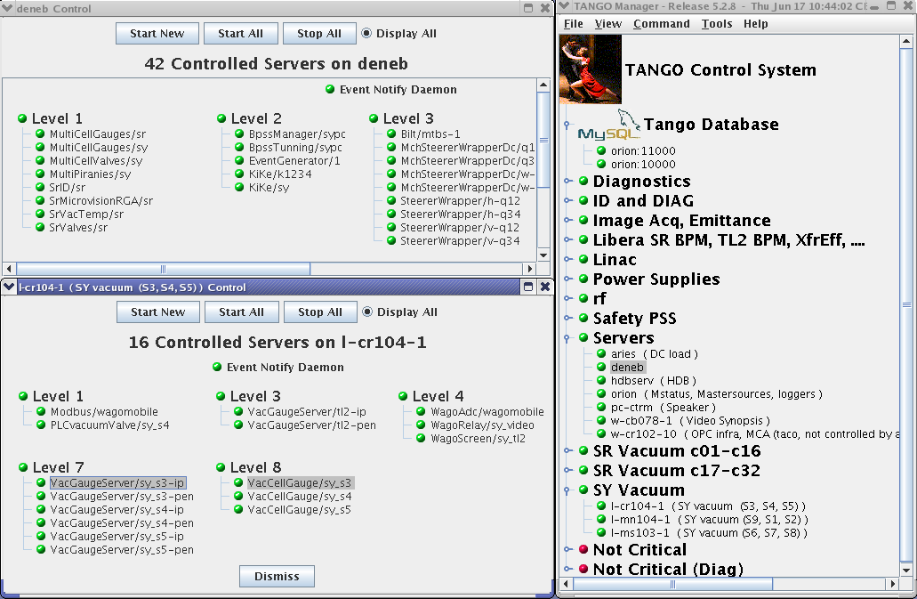
Vacuum Control System
For Booster.
For Storage Ring after winter shutdown.

Slide 17
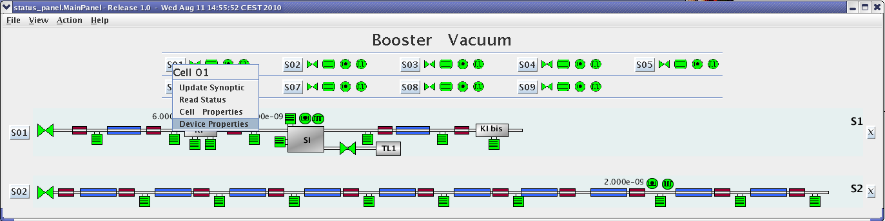
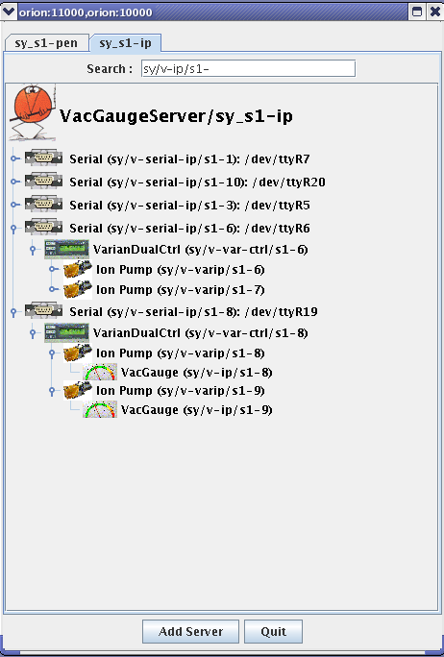
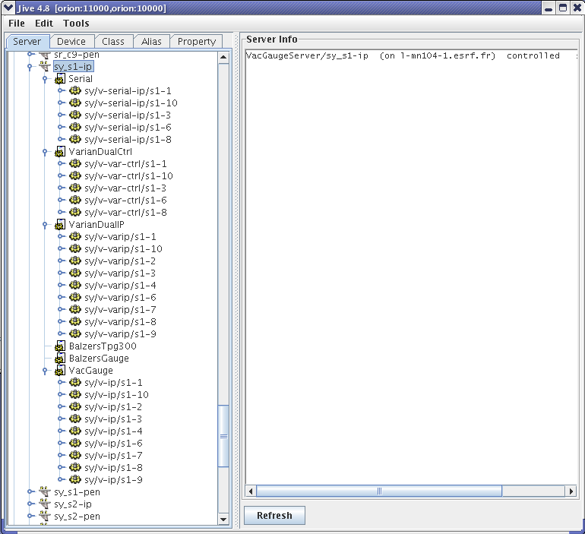

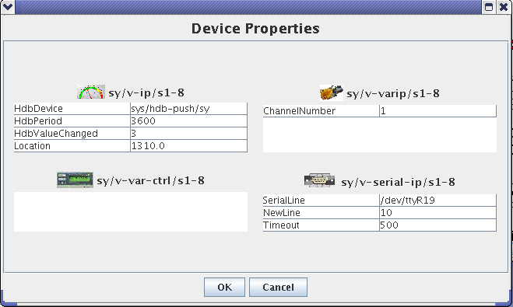
Vacuum Control System
For Booster.
For Storage Ring after winter shutdown.

Slide 18
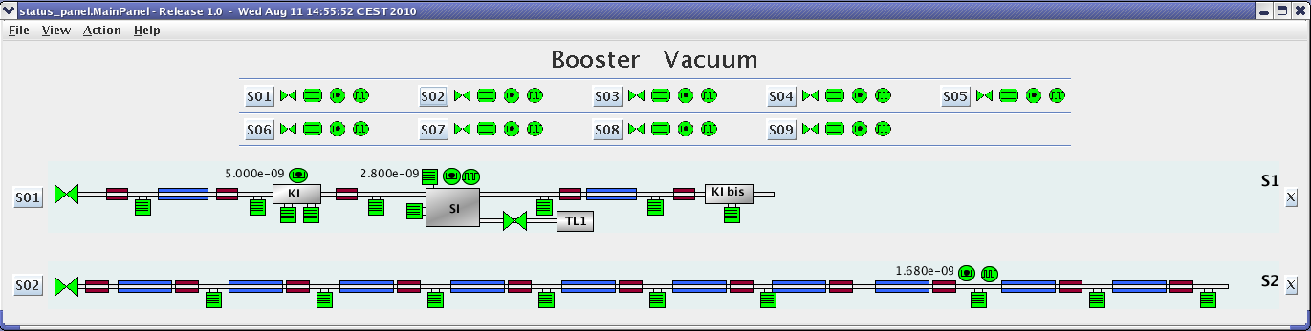
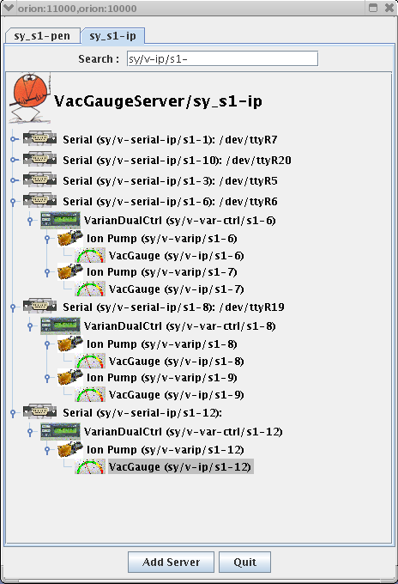
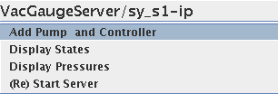
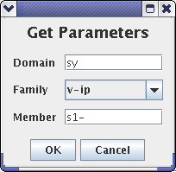
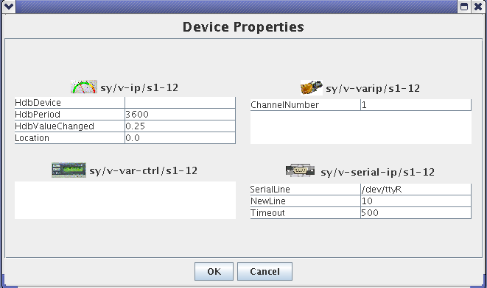

Vacuum Control System
Add a pump

Slide 19
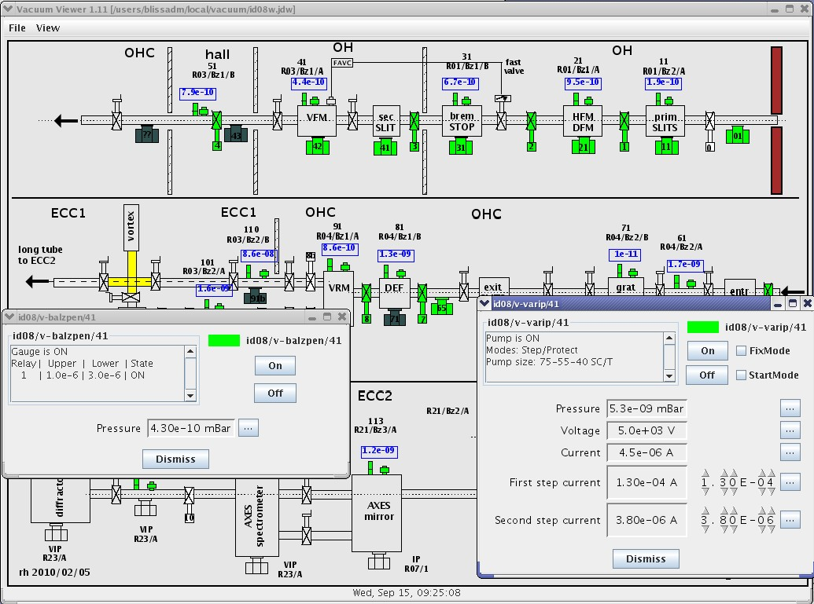
Vacuum Control System
On beamlines (installation phase on ID08).

Slide 20
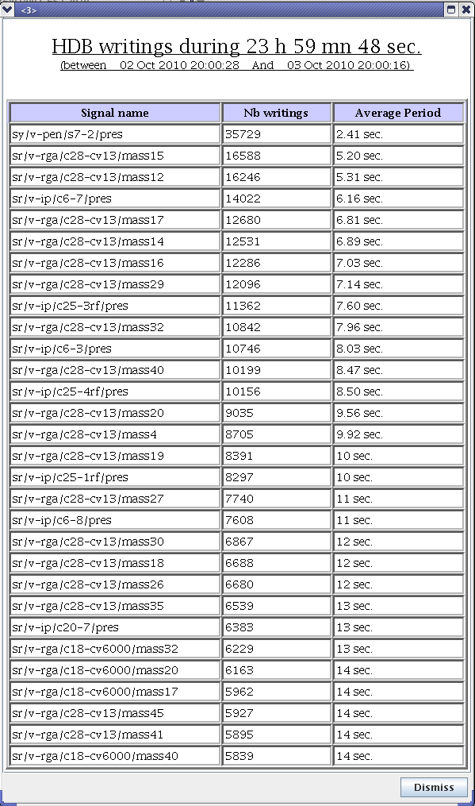
Vacuum Control System
New diagnostics

Slide 21

ESRF Vacuum Control System
Pascal Verdier
ISDD software group
4th of October 2010
New Vacuum Application
New Vacuum Servers
How to manage servers

Slide 22
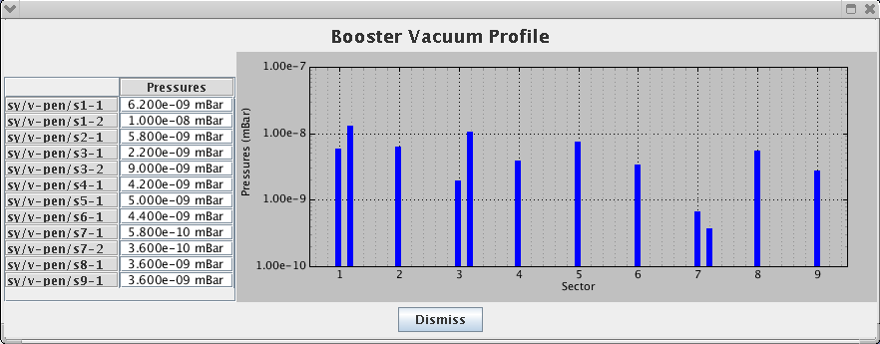
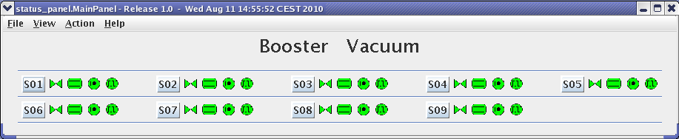
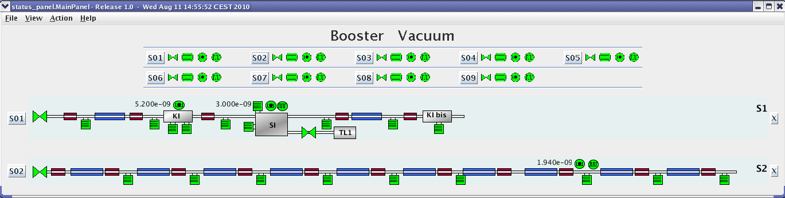
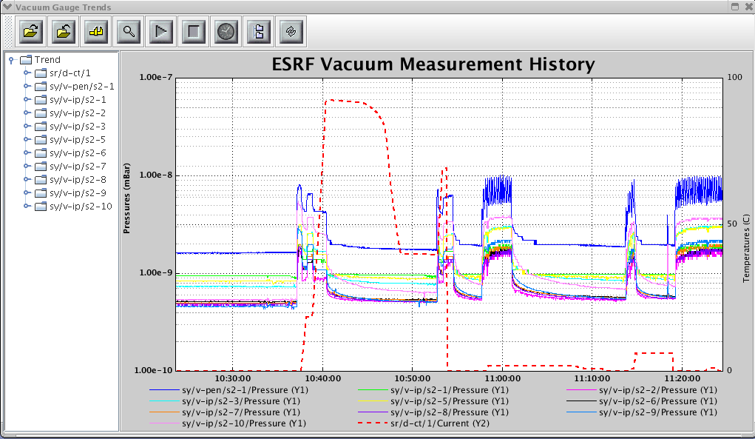
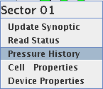
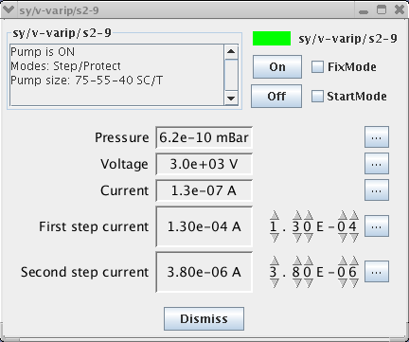
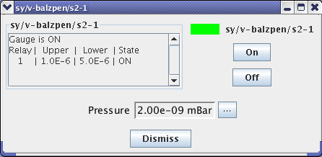
Vacuum Control System

Slide 23
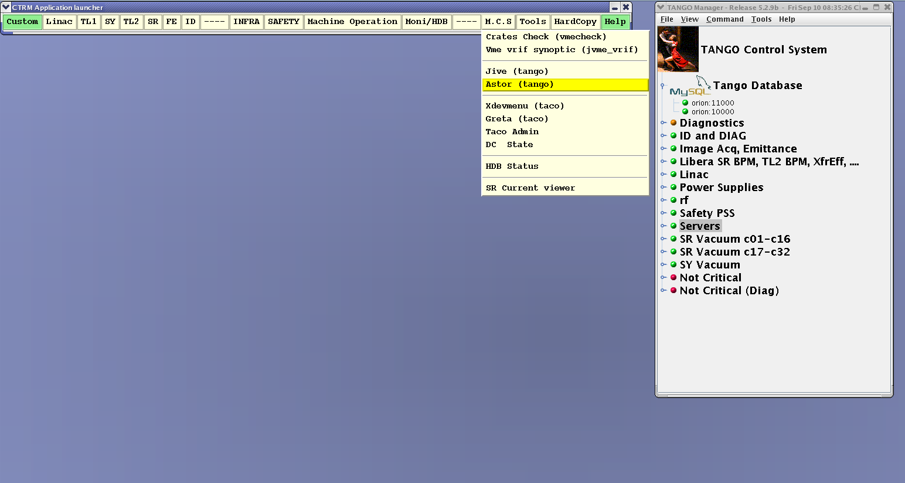
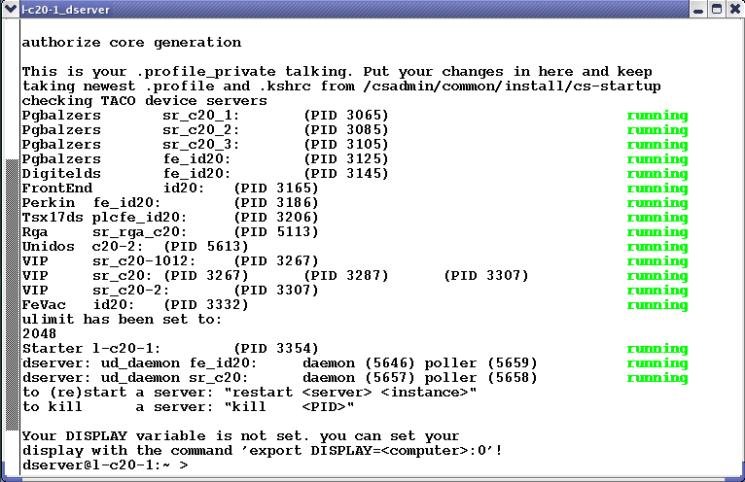
Vacuum Control System
Tango manager tool : Astor (combined with Starter device servers)

Slide 24
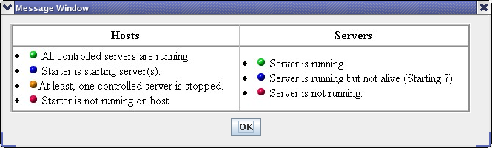
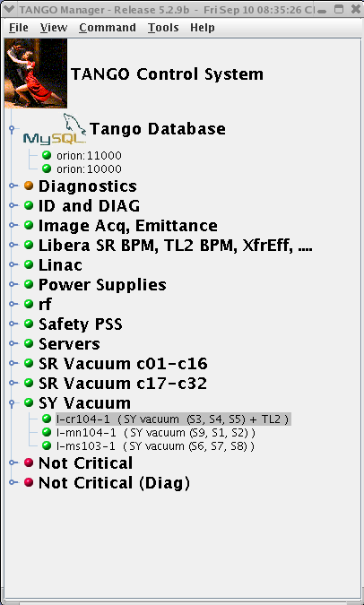
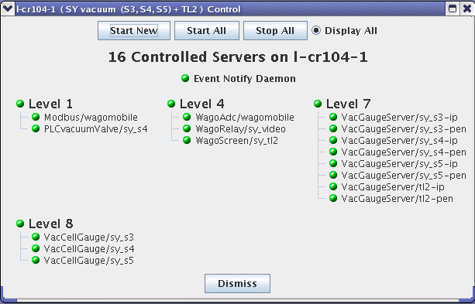
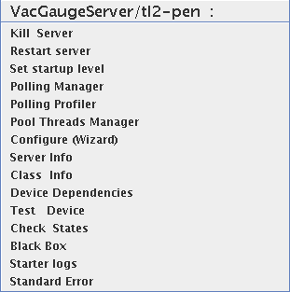
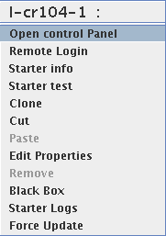
Vacuum Control System

Slide 25
Vacuum Control System
Tango Spectrum
Attributes and
History
Pure Tango Pressures principle:
- 1 server for the storage ring (MultiCellGauges)
- 1 server for each cell (VacCellGauge)
- 1 server for pennings / cell
- 1 server for ion pumps / cell
Tango Spectrum Attributes
MultiCellGauges
VacCellGauge
VacCellGauge
VacCellGauge
32 Servers
Tango Scalar Attributes
VacGaugeServer Tango server
VacGaugeServer Tango server
VacGauge
VacGauge
VacGauge
VacGauge
BalzersGauge
BalzersGauge
VarianIP
VarianIP
64 Tango servers
BalzersTPG
BalzersTPG
VarianCtrl
VarianCtrl
Serial class
Serial class
Serial class
Serial class
Serial line
Serial line
Serial line
Serial line
Controller
Controller
Controller
Controller
Gauge
Gauge
Gauge
Gauge
Pump
Pump
Pump
Pump

Slide 26
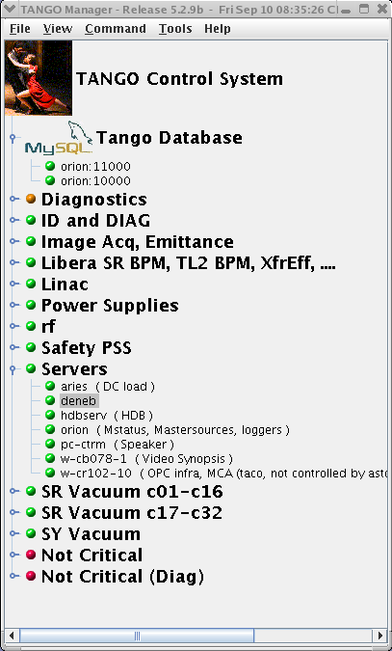
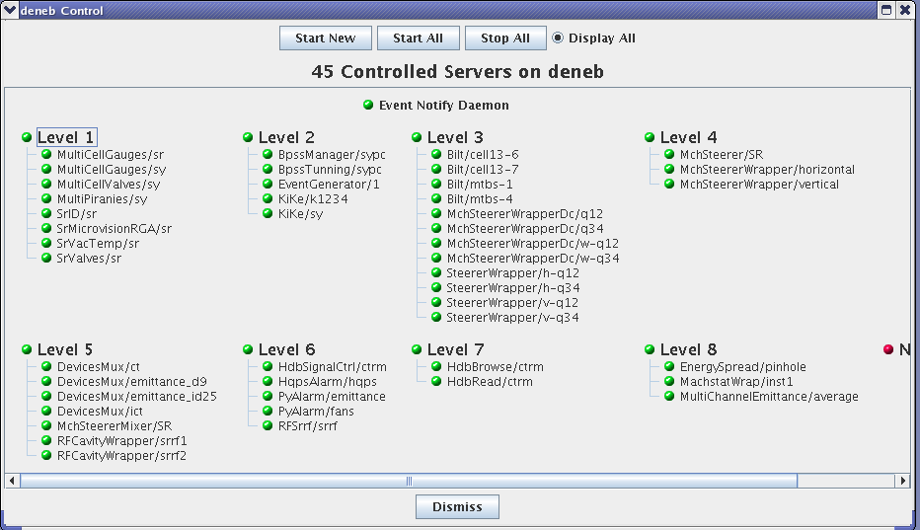
Vacuum Control System

Slide 27
Vacuum Control System
For Booster since summer shutdown.

Slide 28
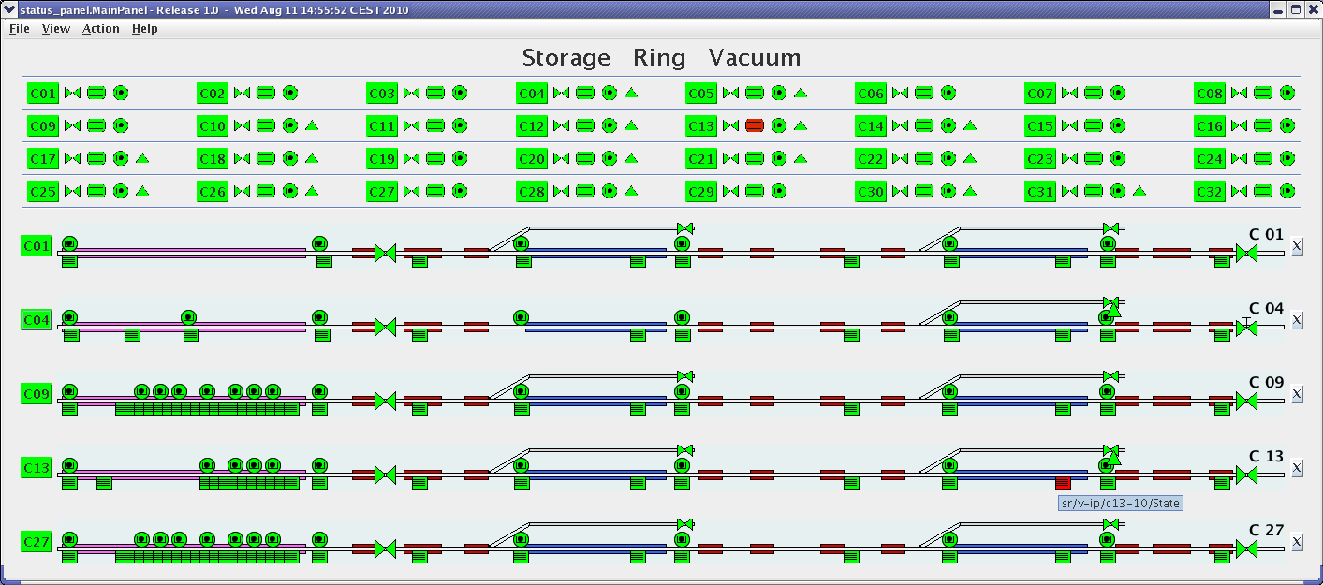
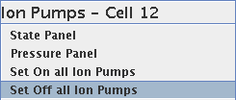
Vacuum Control System
For Storage Ring after winter shutdown.

Slide 29
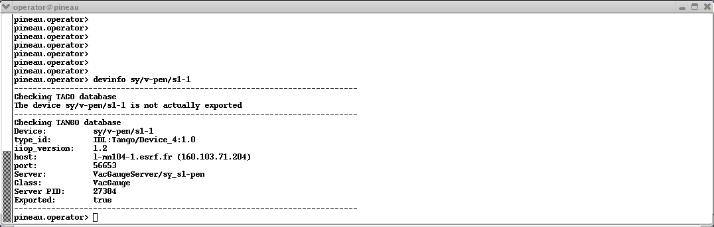
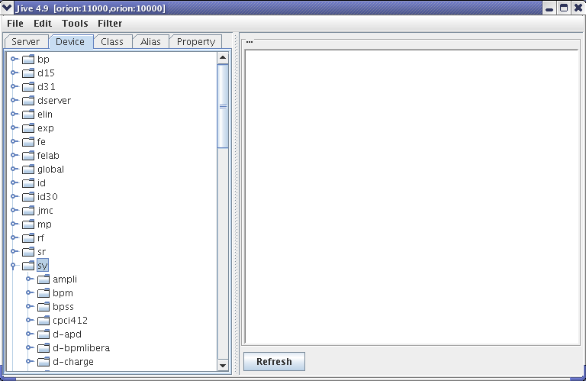
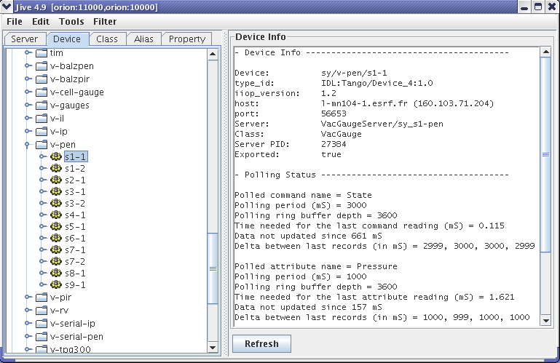
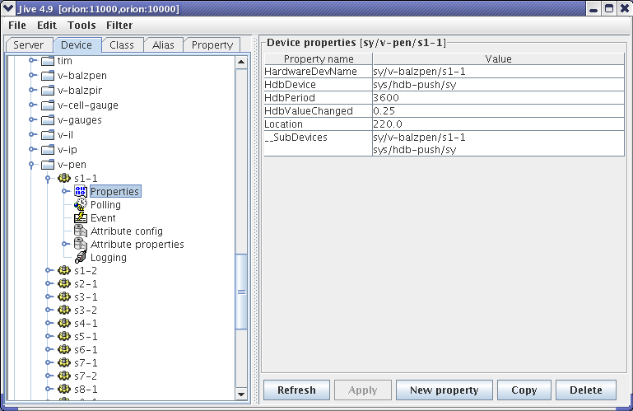
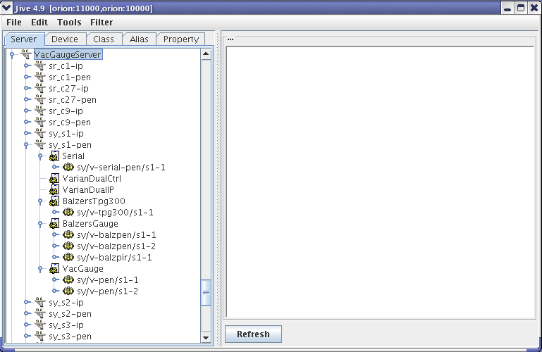
Vacuum Control System
Find a device server.

Slide 30
Thank you!

