Slide 1
A Mobile Platform for Remote Inspection Inside ESRF Tunnel
A tool for minimizing the down-time
Jean-Michel Chaize
David Robinson
Laurent Hardy
Jouni Mattila
Antti Hahto
ESRF
Tampere University of Technology

Slide 2
LabRat project
The context and the need
The project
Design features
Further development

Slide 3
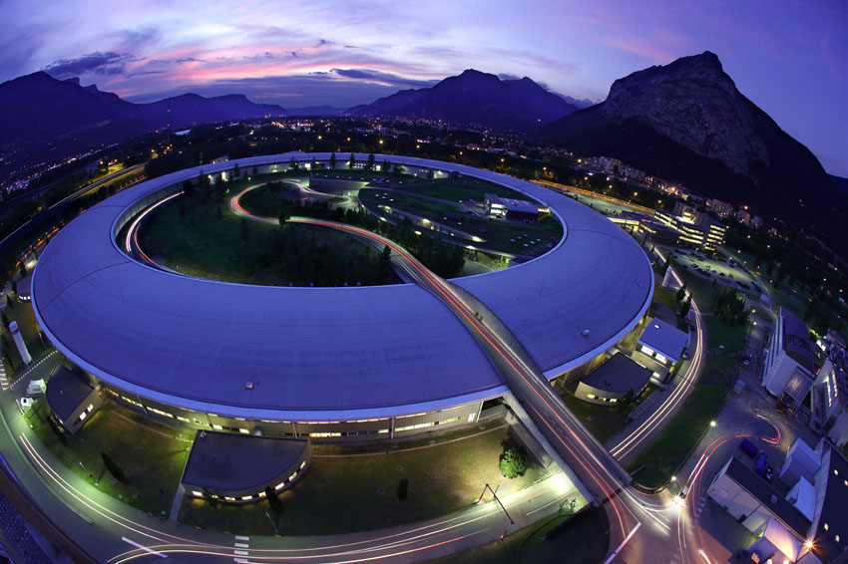
24h operation over 7 days -> NO ACCESS
No way to do visual checks without cutting the beam
no beam cut shorter than one hour
Heating time of the SR equipment
Thermal stabilization time on beamlines optical elements
Etc…

Slide 4
Aging hardware -> Potential problems
Water alarms (pipes radiation damage)
Fire alarms (smoke, hot points…)
Temperature alarms (hot point due to beam)
Motor blocking (mechanical obstacle)
….

Slide 5
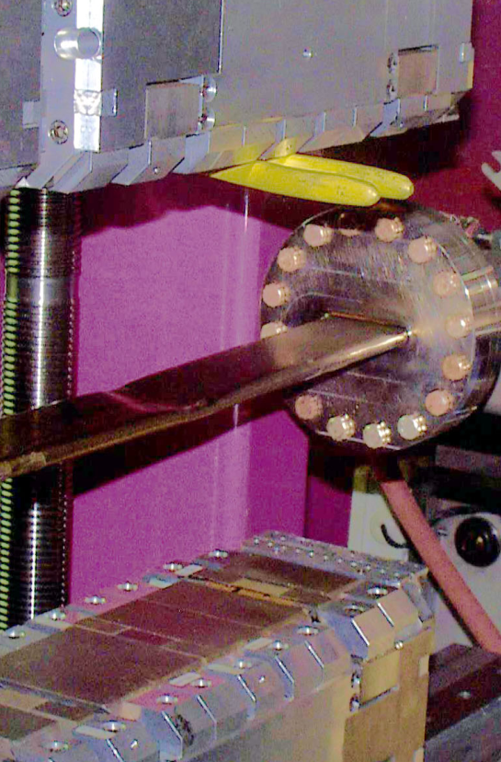
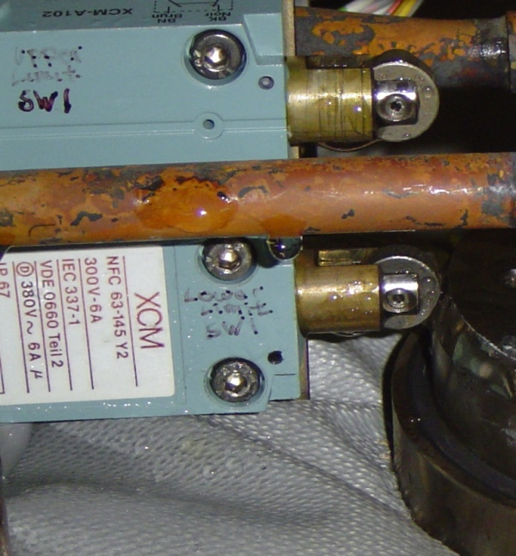
Alarm occurrence: Is it a severe problem ?
Small leak: we can wait and prepare an intervention at an adequate time.
Big problem: it is better to prepare the intervention before cutting the beam
Anyway, we have to cut the beam to check!

Slide 6
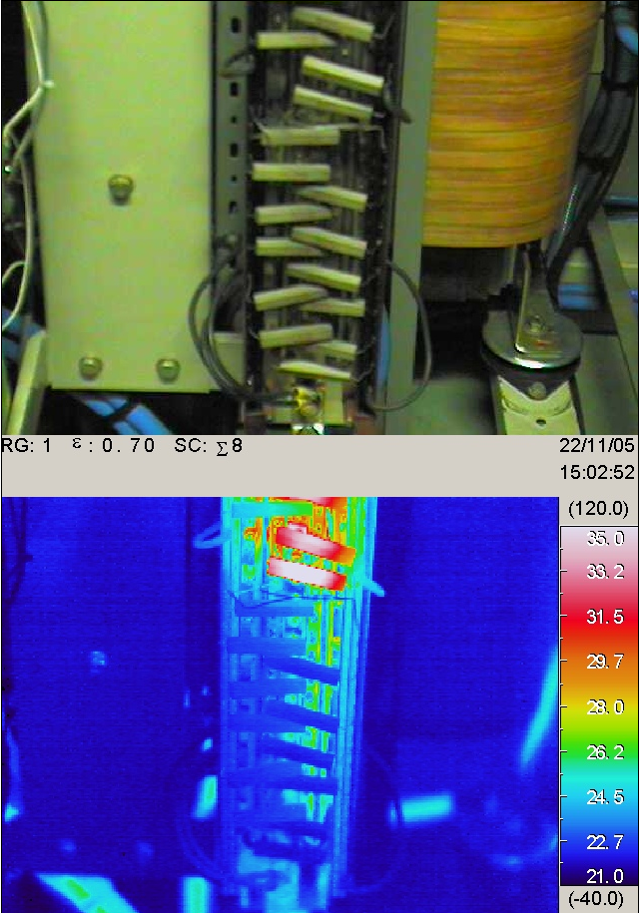
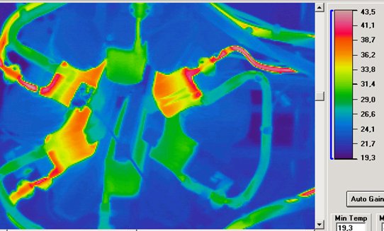
Temperature problems need beam to show-up

Slide 7
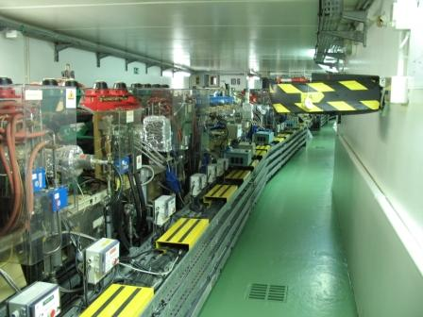
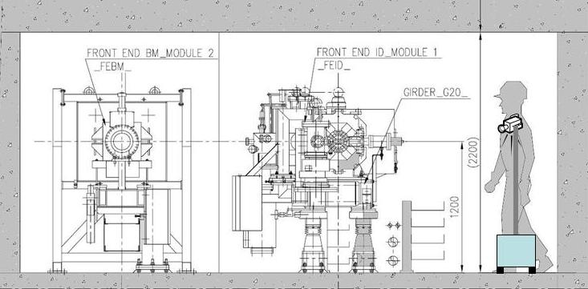
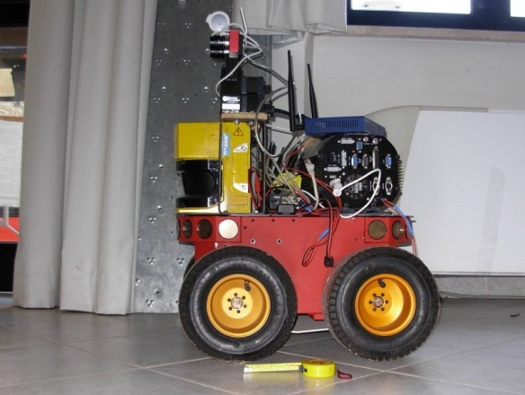
An autonomous robot could help us
Wifi remote operation
Color image transmission to CTRM
Pan tilt zoom high quality video
Movable arm for different point of view

Slide 8
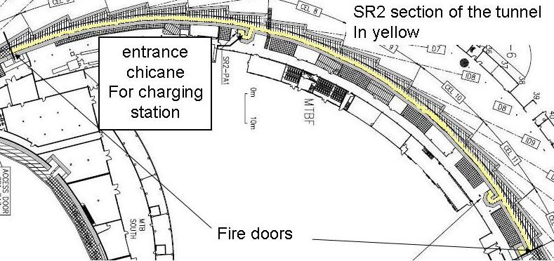
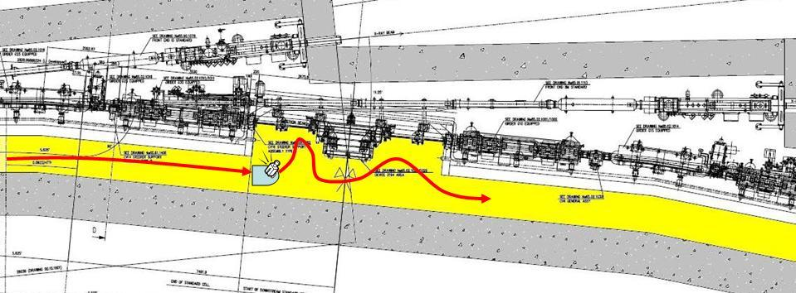
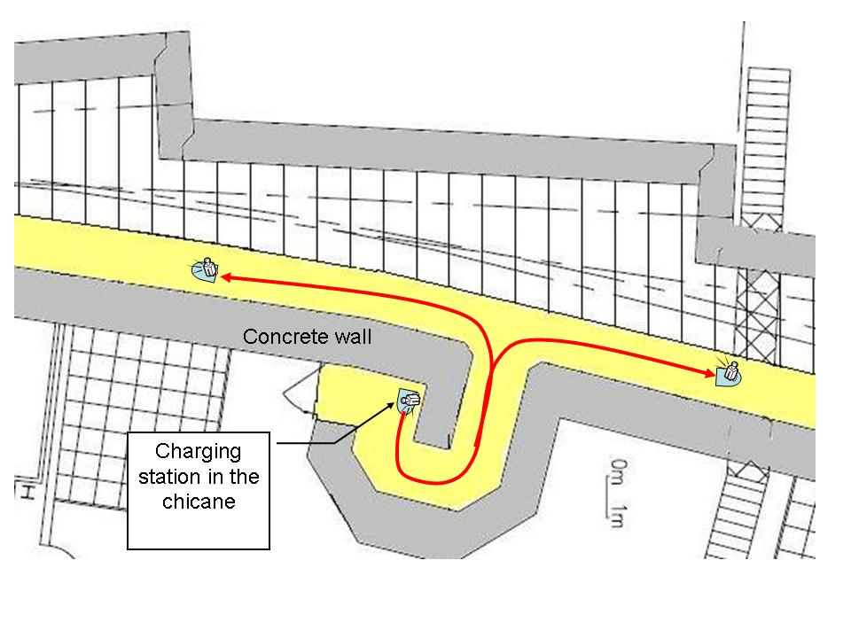
ESRF major constraints
Should stay alive without human intervention for one week
automatic recharging system
Long travelling path (200m)
Should be fast enough
Narrow path (90 cm)
Need several point of view for pan/tilt/zoom camera
movable arm
MTBF should be higher than Storage Ring!
High level of radiation
Shielding = 20Kg minimum for lead!

Slide 9

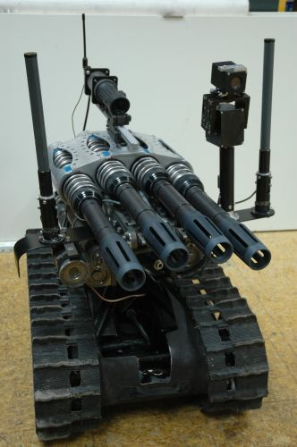

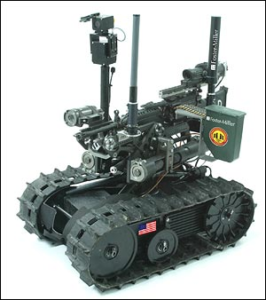
Plethoric choice on the web
Google search on “autonomous robot” give huge and various results…

Slide 10
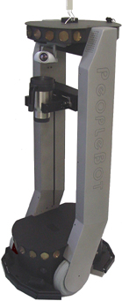
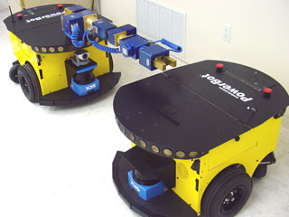
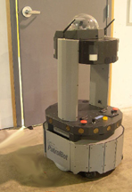
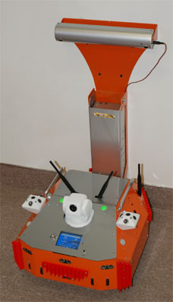
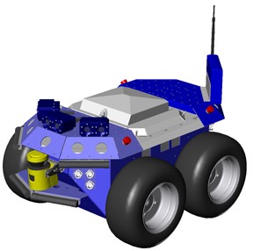
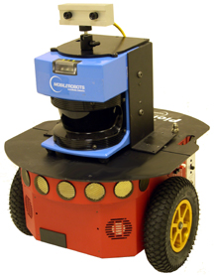
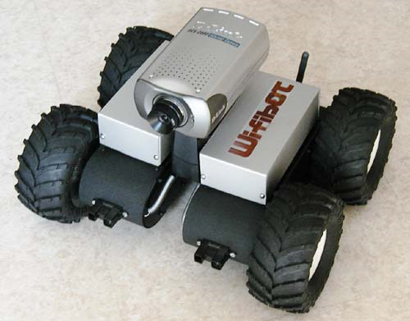
Commercial products
We bought one!
Many tools, market growing rapidly

Slide 11
Learn from experience
Manual joystick remote operation is not sufficient
WiFi coverage sometimes weak
Video transmission freezing -> unsecure situation
Very long travel become tedious.
We need far more than a remote operated car,
The vehicle should be able to go to destination autonomously
If WiFi interrupted-> Continue until target position reached
Should take the best decision in case of unforeseen situation
Reliability is a real issue…
Autonomy for at least one week.
Shielding missing, ->, +20Kg payload -> not possible on many devices
Limited facilities for localization
No GPS, No active transponders, should learn form environment.
Need to be modular and extensible
Infrared camera, radiation measurement etc…

Slide 12

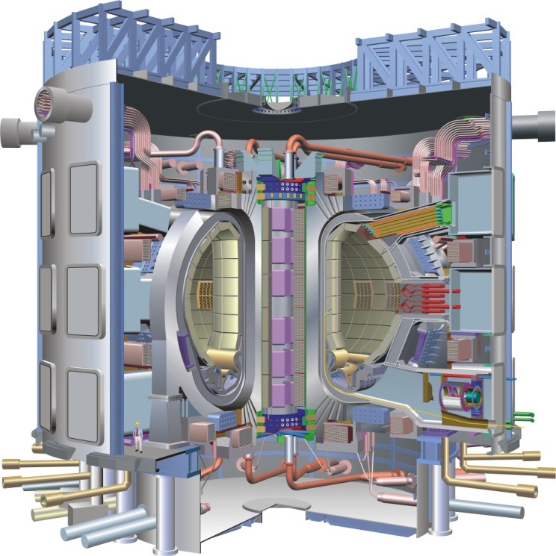
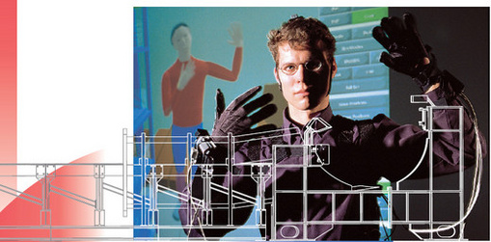
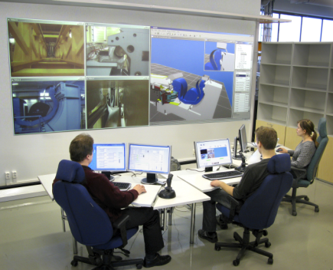
We do not have the necessary competences ->Collaborative project
Found a partner with high level of expertise in robotics
Artificial intelligence, Virtual reality
Remote handling
Intelligency of mobile machine
Mechanical design
Is building a robot for ITER
Interdiciplinarity, cooperation industry,
technology transfer
The Target: Building a tool that can be reproduced and used in other institutes.

Slide 13
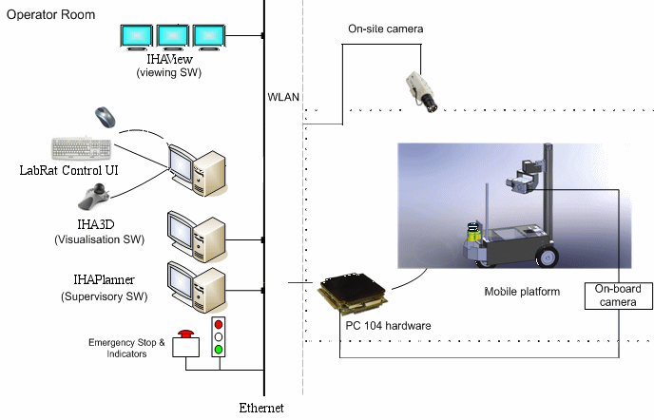
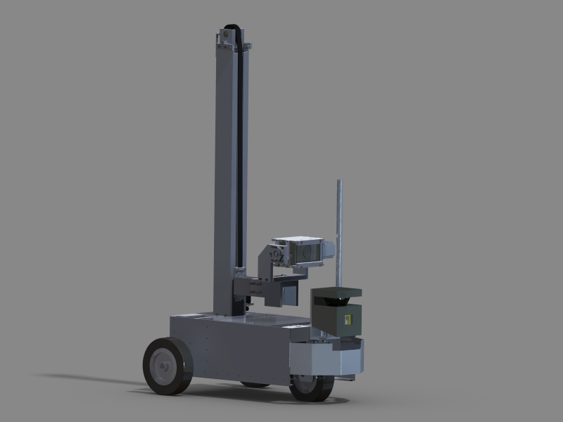
LabRat project: general architecture

Slide 14
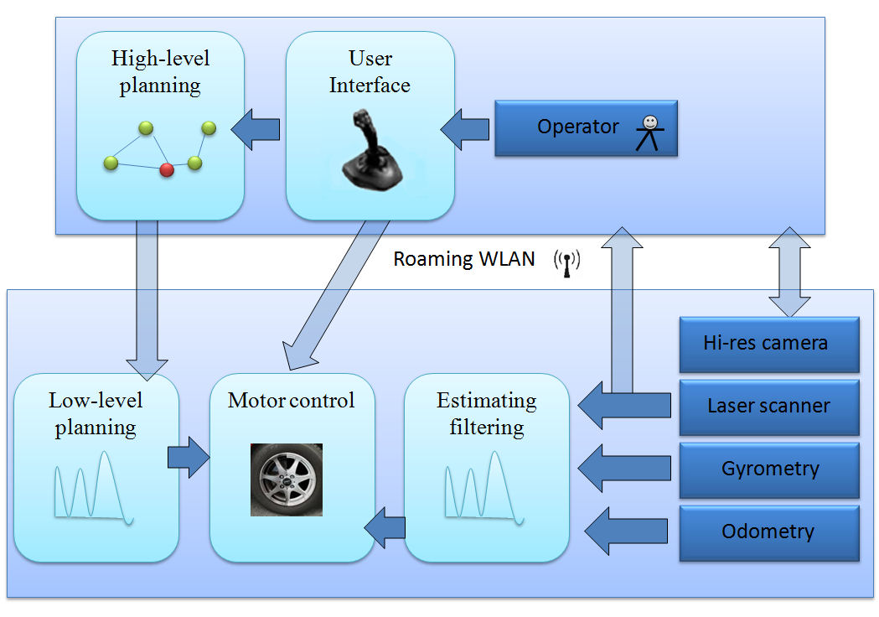
Software architecture

Slide 15
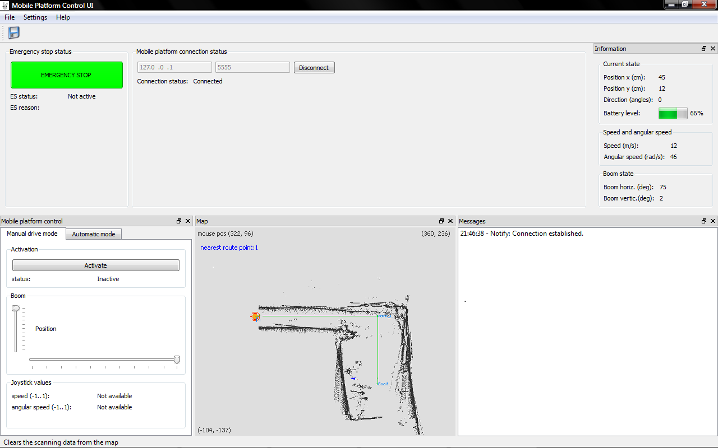
Graphical User Interface

Slide 16
Current status
Mechanical platform working
few improvement are necessary
Path planner software OK
On board camera OK
Automatic charging procedure in development
Commissioning of first prototype in November
For remote observation.
Need intensive tests before entering in the real tunnel…

Slide 17
Further developments
Integration of various detectors
X /Gamma radiation mapping
Pyrometer
Automatic scanning
Scan the tunnel volume with detectors
Do periodical patrol planning
Improve the navigation system
A navigation system based on stereovision
Self learning…
A Tango device server to integrate it in the Control System
Status, alarm, position etc…

Slide 18
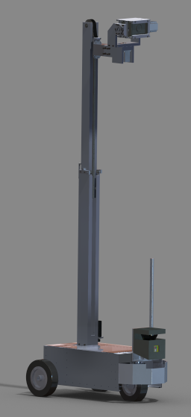
Conclusions
We are close to the first operational prototype.
Our aim is to have LabRat as a standard industrial product
Some R&D efforts still needed
Possibility to obtain some public R&D funding from Finland
For adjusting LabRat to synchtrotrons’ needs, R&D project
Looking for synchrotrons willing to test the product and partner in the development
Pls. contact: Jouni.Mattila@tut.fi or chaize@esrf.fr

